Slide 1
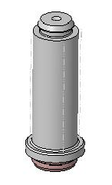
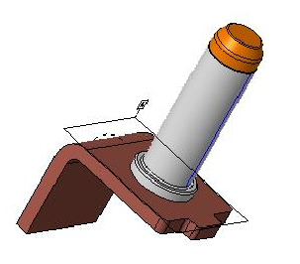
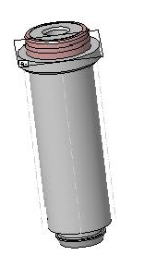
Phase-Out
Running Change: Lower component → material number change
Upper component → no material number change
Lower Component
Technical change
Upper Component
307108 Pin Radsok Kontakt gelasert
From 6783 Hofeditz
By Laser
383739 Radsok Contact-kpl B1-Muster
Inhouse-Production
Phase-In
Lower Component
Technical change
307779 contact pin D14 nachgedreht
From 6729 Hezel
By Turning Machine
SSCM W. Becker 15.02.2021

Slide 2

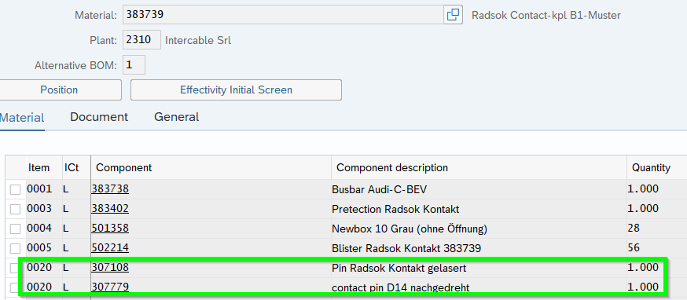
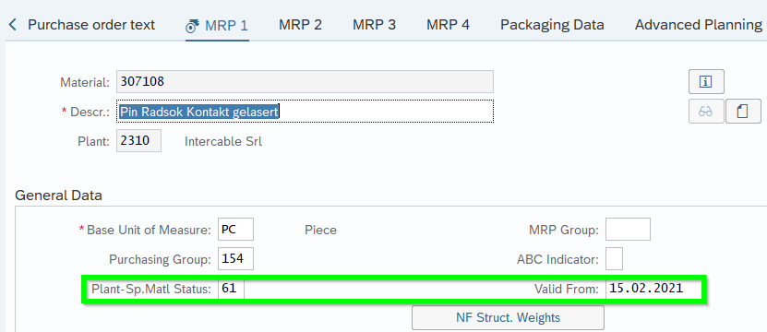
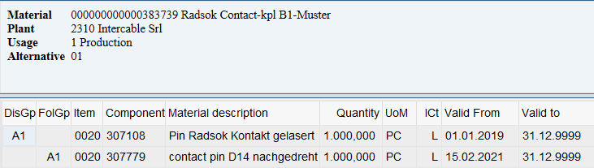
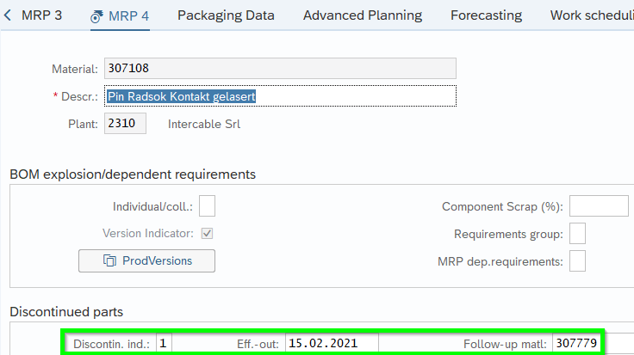
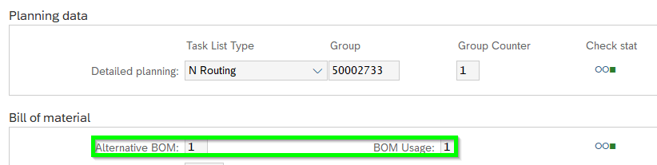
Setting
Running Change: Lower component → material number change
Upper component → no material number change
MM02 Master Data
Lower Component 307108
CS02 Routing
Upper Component
Set Plant-Sp.Matl.Status to 61 plus date from which no more SAP-replenishment elements like Purchase Requisition or Planned Orders should be created anymore:
Add Run-In item in Bill-of-Material (BoM) Pos 0020:
Maintain Discontinuation A1 via double-click on both Item 0020 as shown:
Set Discontin. Ind. To 1 plus Start Date for Eff.-out from when the run-out based on remaining stock should start. Follow-up matl. 307779 needs to maintained as well:
Make sure that ProdVersion being set correctly to upper BoM:

Slide 3
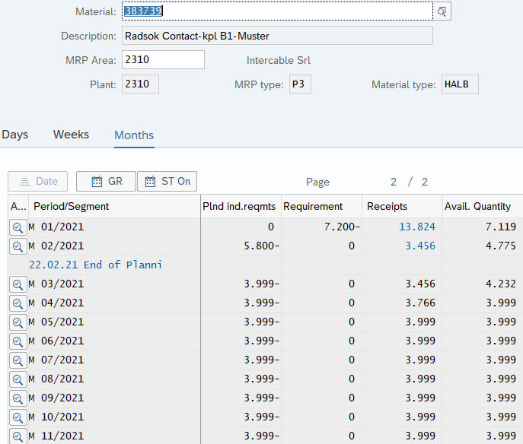
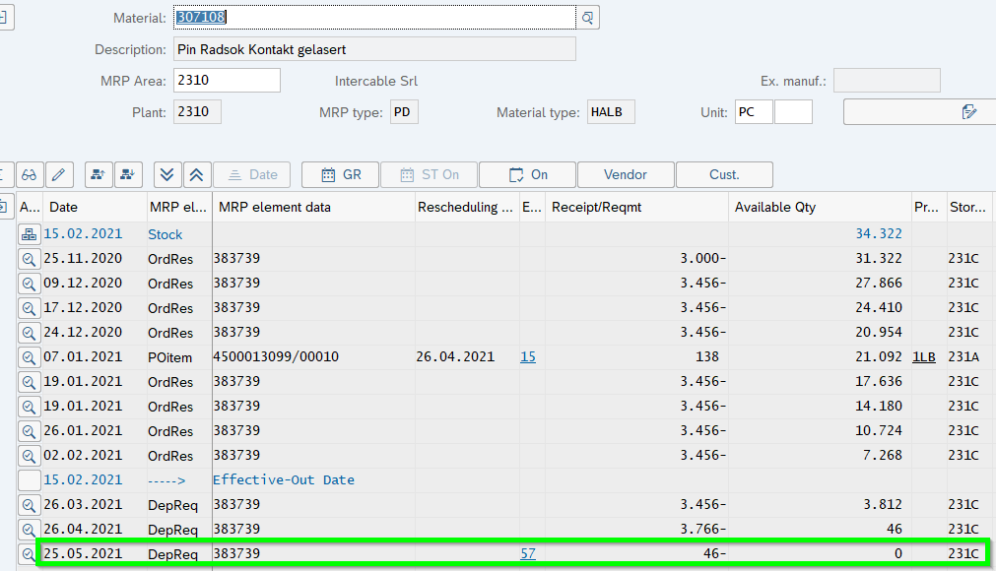
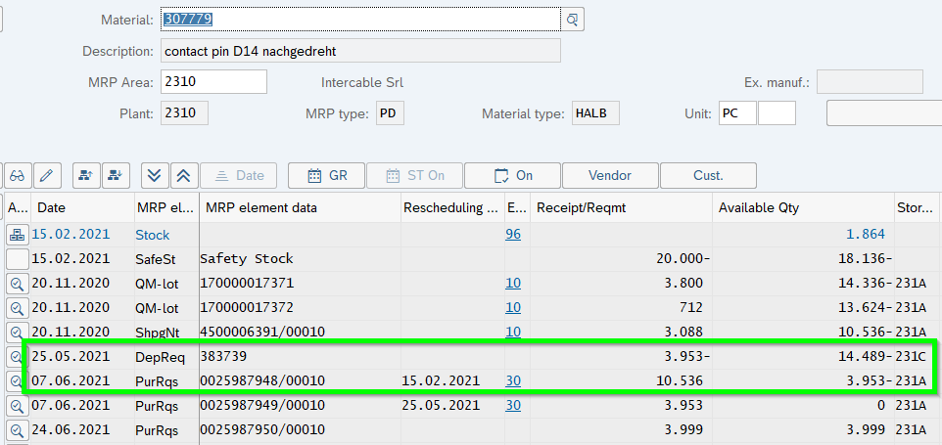
Result
Running Change: Lower component → material number change
Upper component → no material number change
Lower Component
Upper Component
Phase-Out: 307108
Phase-In: 307779

