Slide 1

synapsis communication deck
synapsis connects data, processes, systems and people across functions, regions & systems

Slide 2
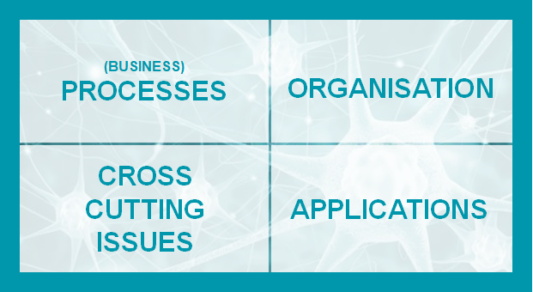
synapsis: Management Summary
synapsis as a driver of our fundamental digital business transformation
“A globally uniform data, process and system landscape for the DRÄXLMAIER Group
in order to increase substantially the efficiency, speed and transparency”
synapsis Scope
DRÄXLMAIER global Template
Rollout Roadmap (Go-Live)
Guiding Design Principles
Benefits
All automotive products / regions, functions and legal entities
Replace legacy systems
New Operating Model
Non-descriptive material number
2020: Pilot rollout BRA
2021 (EMEA):
BS-LEI
CS/BS-TIM (& ELFE)
2022 (EMEA):
Go-Live TEM und LAN
RetroFit BRA
2023ff (EMEA, AM, CN)
OC-TIM-data wires
HV-SAT, SLP, Jinbei
IS/SY-Rollouts
2025ff (EMEA, AM, CN)
ES: Rollouts / CKD-locations (to be decided)
Harmonization of processes
Standardization within
the SAP system
Master Data standardization
Integration of mass
and value flow
Integration of Series,
Pre-Series, Non-Series and CKD
Rollout per site
Real time data: accessible any time
Single source of truth & transparency (BoM, BoP, stock loss, scrap)
True inventory tracking
Daily, real-time MRP
Usage mobile devices
High availability and shorter training periods for new employees
Multilingual solution
S/4HANA: future of IT Solution guaranteed
Localization
CS
HV
BS
DGT
Core
IS
ES
SY
Notes:
MRP: Material Requirement Planning or Manufacturing resource planning.

Slide 3
The target: Our mission - why and what for?

Slide 4
synapsis as a driver of our fundamental business transformation
Through the program synapsis we create the conditions to substantially increase the efficiency, speed and transparency at the DRÄXLMAIER Group, particularly for indirect processes.
Our aim is to create a globally uniform process and system landscape for the DRÄXLMAIER Group in order to become even more efficient and thus to remain sustainable and competitive.

Slide 5
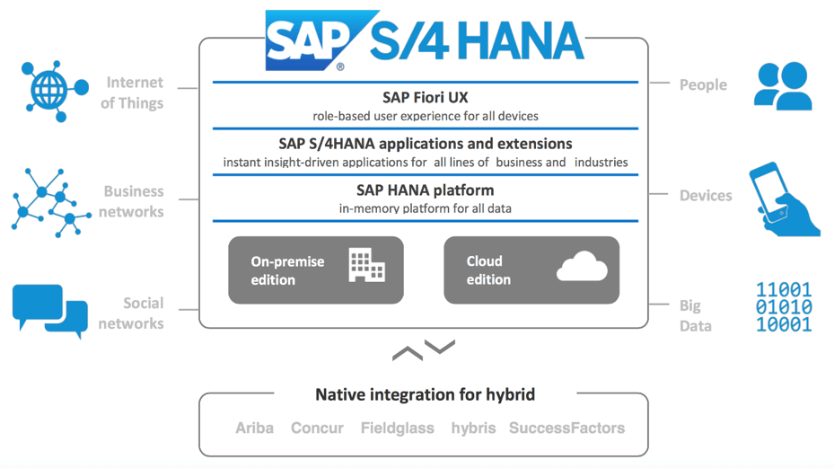
What is “S/4”?
About SAP S/4HANA
“S/4” is short for the SAP Business Suite 4th generation, a single platform allowing companies to collect, transact, and report on data from all company business activities across multiple functions.
S/4 HANA enables the information flow between different parts of a company and with outside stakeholders like customers and suppliers.

Slide 6





Why “SAP S/4”?
SAP eliminates information silos and standardizes data across an entire company or multiple companies.
Disparate enterprise systems & data
Finance
Supply Chain
Production Planning
Sales & Distribution
Customer
Experience
Human Resources
One standardized & connected system
Finance
Supply Chain
Production Planning
Sales & Distribution
Customer
Experience
Human Resources
S/4 Key Benefits
1
Streamlined & automated processes
2
Real-time insights and better decision making
3
Simplified data model and customizable deployment

Slide 7
The project: General information - what? who? when? how?

Slide 8

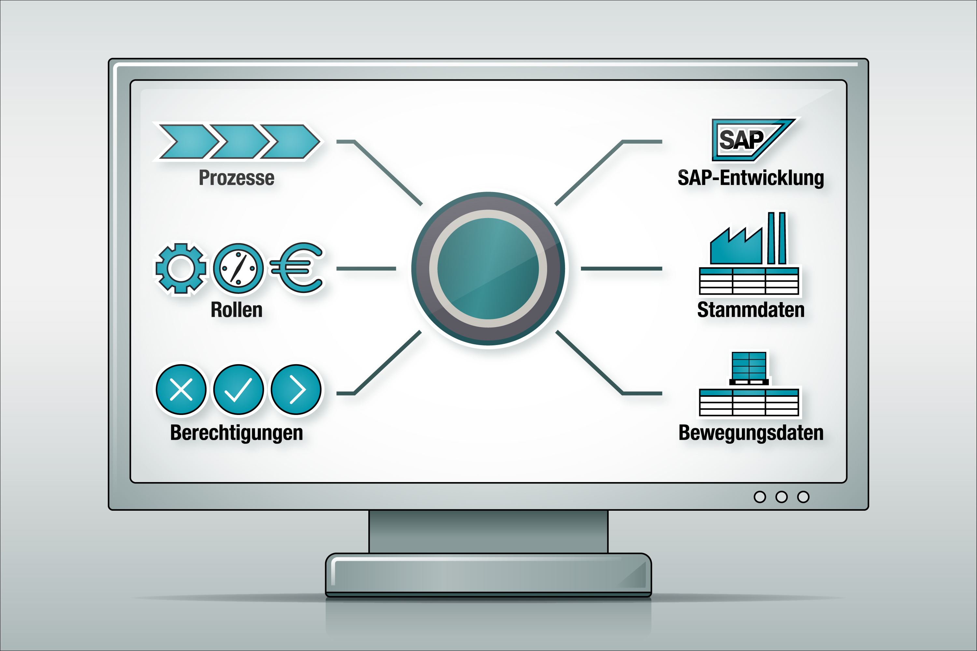
Start
the explanatory video

Slide 9

The entire company is affected by synapsis
Improvements realized by SAP S/4HANA along the End-to-End process
Master-
data
Pur
chasing
Costumer order
Planning
material
requirement
Inbound logistics
Production
Outbound logistics
Finance & costums
Delivery
schedule
Order
execution
Goods
control
store
Produc
tion
planning
Manu
factor
ing
Costs
monitor
Picking
Delivery
Invoicing
Export
Self-
billing
Quality / Accounting & Controlling / Engineering & Change Management / Costums
Automated Data transfer
System continuity
Integrated quantities and value flows
New Operation Model
Improved transparency with „real-time“ data
Consistent knowledge through reduction to one system
Fully integrated system
Consolidation of all information
(same source for all reports)
Lower error frequency by eliminating system breaks
Notes:
Die Einführung von SAP betrifft das gesamte Unternehmen, alle Prozesse entlang des Wertstromes sind betroffen von dieser Veränderung.
Die Vorteile, die sich das Unternehmen von der Einführung von SAP verspricht, sind vielfältig. Daten wrden in Zukunft automatisch zwischen den verschiedenen Systemen und auch verschiedenen Bereichen transferiert. Damit erreichen wir ein höhere Transparenz für Daten, Reportings oder den aktuellen Status zum Produkt.
Die Fehlerhäufigkeit sinkt, weil Systembrüche eliminiert warden.

Slide 10


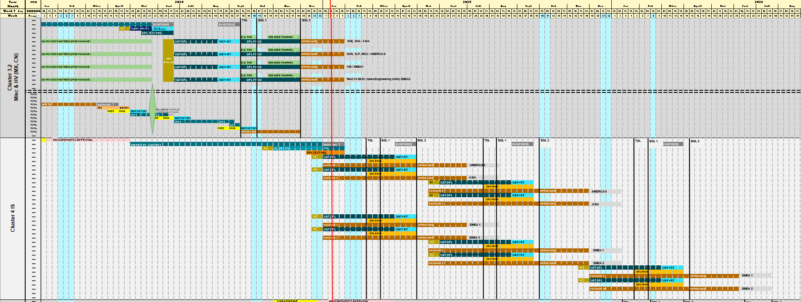
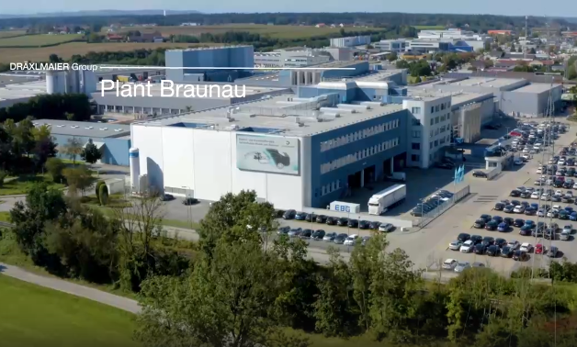
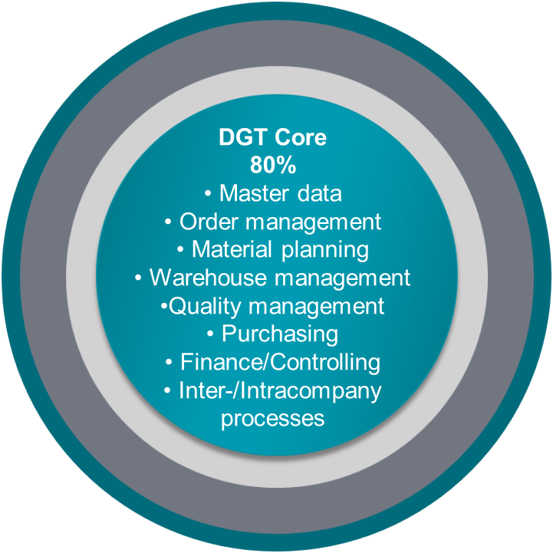

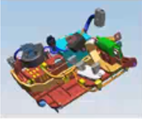
synapsis Achievements & Outlook
current Planning
10/2015-04/2016 Org. Readiness Phase
30.05. Kick-Off Analysis & Design Phase
06/2016 Boot Camp
.
DRÄXLMAIER Global Template (DGT):
31.03. Kick-Off Realisation Phase
31.07. Fit/Gap Gate
31.12. End Release 1.0
Pilotsite Braunau, Austria, Release 1.2:
Analysis, Prep., Fit/Gap, Design & Build
05.10. Go-Live
Pilot Site Braunau Release 1.2 (CS), Austria 
Start TPM & new synapsis Program Management
03/2022 Go-Live Ambient Light & AMG Battery TEM
04/2022 RetroFit Braunau
05.07. Go-Live BMW Gen5 Landau
07/2022. Kick Off Scan & Prepare Phase Cluster 3.1 incl. High Voltrtage site in Asia&Americas
Cluster 3.2: Misc & HV (MX, CN):
01.12. Go-Live SHE, SHA, Asia
01.12. DUN, SLP, MOU, Americas
01.12. VIB, EMEA1
01.12. Rest C3 MISC
Cluster 4:
01.04. Go-Live
EMEA1 P 9
EMEA2 P10
Cluster 5:
01.04. Go-Live
Americas, Asia Px
01.09. Americas, Asia, EMEA1, EMEA2 Px
2016
2017
2018
2019
2020
2021
2022
2023
2024
2025
2026
2027
01.05. Go-Live Hunedoara (CS), Romania
Cluster 3.1: SAT (HV), BIW, SAC, TEM:
01.12 Go-Live Bischofswiesen, Germany
01.12. Go-Live Satu Mare, Timisoara
Today
Cluster 4:
01.05. Go-Live
EMEA1 Package (P)1
EMEA2 P2
Americas P7
Asia P8
01.10. Go-Live
EMEA1 P5
EMEA2 P6
Americas P3
Asia P4
Cluster 5:
01.02. Go-Live
Americas,
Asia, EMEA1, EMEA2 Px
01.07. Go-Live
Americas,
Asia, EMEA1, EMEA2 Px
DGT Core Design
DGT Extension
03-06/2019
Short-Time Work
Re-Evaluation
15.11. Re-Start
synapsis 2.0
5.07. Go-Live Battery Plant Leipzig (BS) 
4.10. Go-Live Timisoara (CS/BS), Scope: AMG S-Box & affected FIN&NSL processes in Hunedoara
Re-Calibration synapsis (Cluster & MVP approach)
Notes:
Cluster $

Slide 11
Program Rollout in general
Test Complete
User Acceptance Tests
Milestones
Kick-off
Scope Freeze
Business Go-Live
Handover
Project phase
Preparation Training
Scan & Prepare
Requirement Approval
Design & Build
Rollout Phase
Hypercare
Plant impacts
Plant preparation
Sustainable operation & continuous improvement
Local Process Partner
Nomination & Onboarding
operations – program oriented
operations – plant oriented
Local End User
Basic Training
Specific Training
Training on the job
RUN Organisation
Enablement
operation support

Slide 12
High Level Roadmap
Please always check for updates before communicating this slide.
2022
2023
2024
2025
 | Jun | Jul | Aug | Sep | Oct | Nov | Dec | Jan | Feb | Mar | Apr | May | Jun | Jul | Aug | Sep | Oct | Nov | Dec | Jan | Feb | Mar | Apr | May | Jun | Jul | Aug | Sep | Oct | Nov | Dec | Jan | Feb | Mar
Rollout Release 1.3 HUN (CS)
Cluster 3.1 SAT (HV), BIW, SAC, TEM
Cluster 3.2 SHE (HV), SLP (HV), Misc.
Design & Build
(incl. ITC)
HUN
Rollout
(incl. UAT, End User Training)
HUN
Hyper care
HUN
ITC HUN
Go-Live HUN
Rollout (incl. UAT, End User Training)
BIW, SAT, TEM
Hypercare
BIW, SAT, TEM
Scan & Prep incl. Requirements & Approval
SAT, SHE, SLP
Design & Build (incl. ITC)
SAT, SHE, SLP
Rollout (incl. UAT, End User Training)
SAC
Hypercare
SAC
ITC BIW, SAT, TEM
Go-Live BIW, SAT, TEM
Go-Live SAC
Scan & Prep incl. Requirements & Approval
SHE, SLP, Misc:
legal requirements
Design & Build (incl. ITC)
SHE, SLP, Misc.:
legal requirements
Rollout
(incl. UAT, End User Training)
SHE, SLP, Misc.
Hyper care
SHE, SLP, Misc
ITC SHE, SLP
Go-Live SHE, SLP

Slide 13
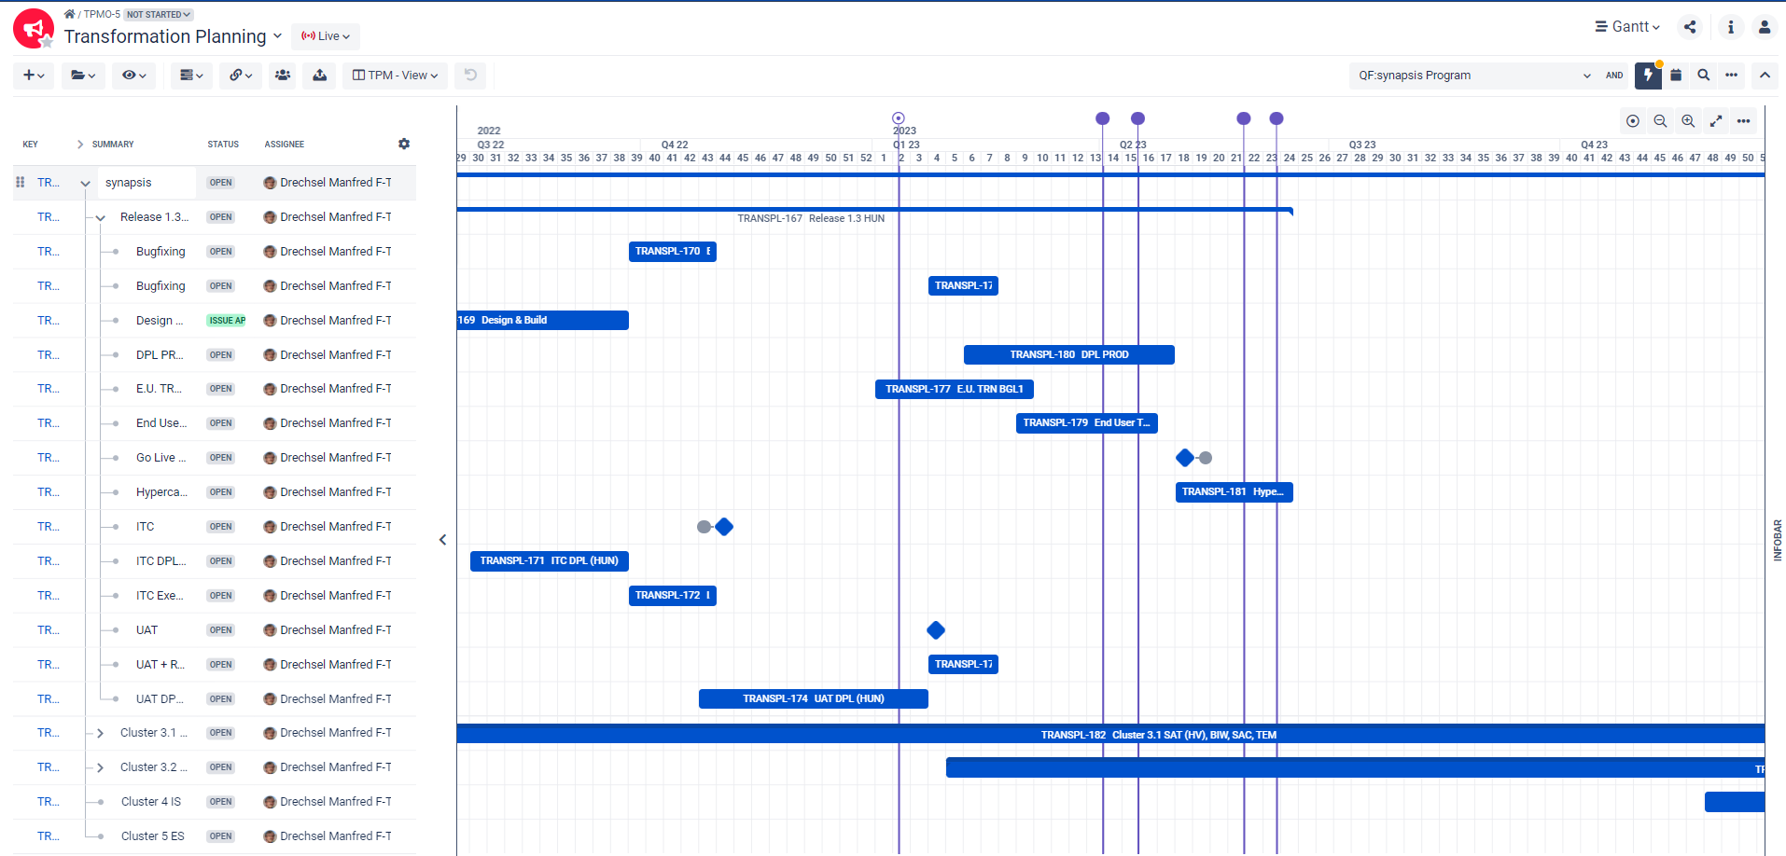

Roadmap and High Level Release Plan - Digital Core
Update needed
Link to Roadmap

Slide 14
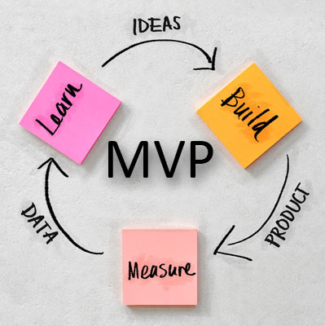
DRÄXLMAIER Global Template (DGT) &
Minimal / Minimum Viable Product¹⁾ (MVP) in a nutshell
WHAT - Processes, Systems
HOW - in order to ensure Functionality (Depth of Implementation)
Consideration of all categories of the digital value stream:
people & organization, process, data, system / tool
Responsible functions must define the business processes
Industrialized rollout approach cluster
Implementation of the essential functionalities
Product characteristic
(CS, BS, IS, SY)
Bill of materials, routing
Material resource planning
for components
DGT Core
80%
Master data
Order management
Material planning
Warehouse management
Quality management
Purchasing
Finance/Controlling
Inter-/Intracompany
processes
Product characteristic (ES)
Bill of materials, routing
Module logic
Push & (pull) principle
Localizations
As few as possible,
as many as necessary
Legal requirements
Local requirements
1) A minimum viable product, or MVP, is a product with enough features to attract early-adopter customers and validate a product idea early in the product development cycle. In industries such as software, the MVP can help the product team receive user feedback as quickly as possible to iterate and improve the product.

Slide 15
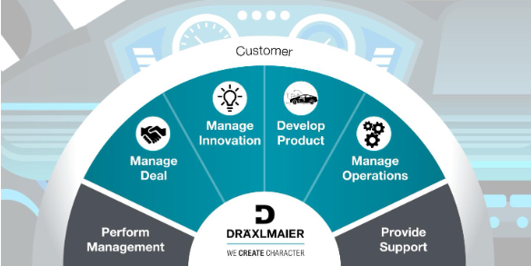
Digital Transformation – TPM Program Organization
Categories by focus topics
CEO
Transformation Governance
Shared support
Transformation Lead
G. Di Loreto
Inhouse Consulting
Transformation PMO
Organization & Business Process Governance*
Board of Experts (BoE)
Test Management
T. Delsor
V. Moeller
O. Heymann
O: G. Schieborowsky
T: T. Kost
F: E. Köylüoglu
P: R. Suvak
H: K. Läkemäker
C: A. Wollsperger
M:T.Steckermeier
S. Mooser
GG-Q / GG-P: J. Elsenbach / H. Kircher
US: Ch. Langstein
CN: L. Zhu
M. Krüger
(act. Dr. M. Junginger)
Data Scope Management
M. Hausperger
Process, roles &
data standardization
Group Governance Processes
H. Kircher
Process Owner / Manager
Global Master Data Owner / Steward
Deployment
J. Cseki
Program implementation
Data Cleansing
O. Hoffmann
sales diamond
Group Calculation
Aurora
Digital Core: Transformation Lead
People, Change & Learning
A. Leptich-Kast, HR
T. Schröder, Learning
M. Kaiser, Change Mgmt
PM-up!
PLMnext
synapsis
MES2
HRevolution
HOST &
legacy systems
Claudia Büchl
M. Bock
act. A. Wollsperger
B. Wagner
M. Strob
O. Hagn / O. Baum
W. Bauer
L. Tabellion
C. Nitsch
Digital value stream
Release & Rollout
Sustainability
tbd
+
Release Governance & Coordination: tbd
Engineering Center by T with releases
CATENA-X
tbd
Synapsis & MES2 Rollout Governance & Coordination: O. Baum
Plants & Distribution Center by O with respective rollouts
Legal Entities, Functions & other sites by Functions with respective rollouts

Slide 16
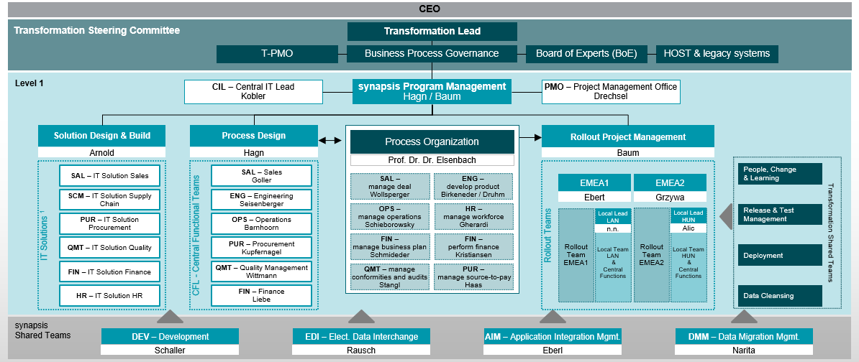
synapsis Organizational Chart
Live document (link)
Last update: Oct. 2022

Slide 17
Our major guiding and design principles
Harmonization of processes overall functions, products, regions
Processes
Maximum of standardization within the SAP system
DRÄXLMAIER Global Template
Future proof architecture
Design to run – sustain-ability and scalability of architecture
Systems
Master Data standardization
Integration of mass
and value flow
Integration of Series
and Non-Series
Data
Rollout per cluster
Shaping the business transformation by a professional training & change management approach
People
DATA
PEOPLE

Slide 18
The modules: Opportunity management - what exactly?

Slide 19

Scope of synapsis
Rule based management
[Quality Management]
Resource management
[Purchasing]
Sales
Information technology management
Develop-ment
Implementation and realization of products
Financial management
Quality
Procurement
Finance
Creation of products
Logistics
Production
HR
All automotive legal entities
All
regions
All segments & products
Delta
SEP process phases A, O, K
SEP process phases E0, E, P
SEP process phases V, S
Qest
(BUSINESS)
PROCESSES*
ORGANISATION
CROSS CUTTING ISSUES
APPLICATIONS
CAS
(FI / CO / NSL)
AVAS
(JIT/JIS)
PLM
Teamcenter,
HED,
Altium
(Development)
Master data
Material number
[non descriptive]
QSYS
(Quality)
BISS
(Container)
Digitization
Optimain
(Production)
SAP/ local HR
(HR)
TCD
(Target Costing Data)
Non-series
Series
Format /
TCUDAP (Customs)
Host
(Sales, Logistics, Purchasing)
Small ERP
(dConn)
TISS
(Transport)
Operations Model
KS-info
(Production)
MES
(Production)
Test stations
(Production)
Aula
(JIT/JIS)
* House of Processes (ADONIS)

Slide 20







Selected improvements through synapsis for the individual functions
DEVELOPMENT
PURCHASING
SALES
PRODUCTION & LOGISTICS
FINANCE
QUALITY
IT
Digital production twin as a prerequisite for "Industry 4.0" - closed loop between development & production
Reduced maintenance effort for material master data due to fewer duplicates
Higher efficiency in change management of prototypes and tools
Integrated corporate planning enables better planning of purchasing quantities and reduces manual effort
Efficient production planning, control and materials planning through integrated planning tool
Improved visibility of spend volume and purchasing conditions
Improved comparability of purchasing and sales conditions through the use of a consistent material number
Use of the same SAP system for series and non-series
Consistent intercompany invoicing model
Reduction of non-series material costs through catalogs
Reduction of material consumption for series production
Efficiency increase in production control (FST), in logistics planning, in maintenance and in the warehouse
Integrated flow of quantities and values
Simplified invoice verification and faster period-end closing
Automatic calculation of sales tax for each transaction
Reporting per plant and per segment
Control of all Q-related activities from notification onwards
Simplification of supplier recourse via the plants and the accounting department
Integration of FMEA process, control plan, inspection planning and complaint handling
System-supported audit planning and execution, including action tracking
Replacement of legacy systems and reduction of interfaces and media disruptions
Increased IT security and improved role and authorization management
Readiness for mobile applications and end devices

Slide 21
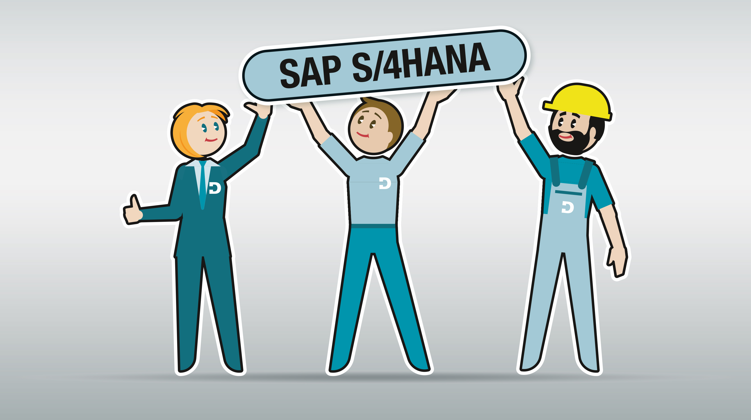
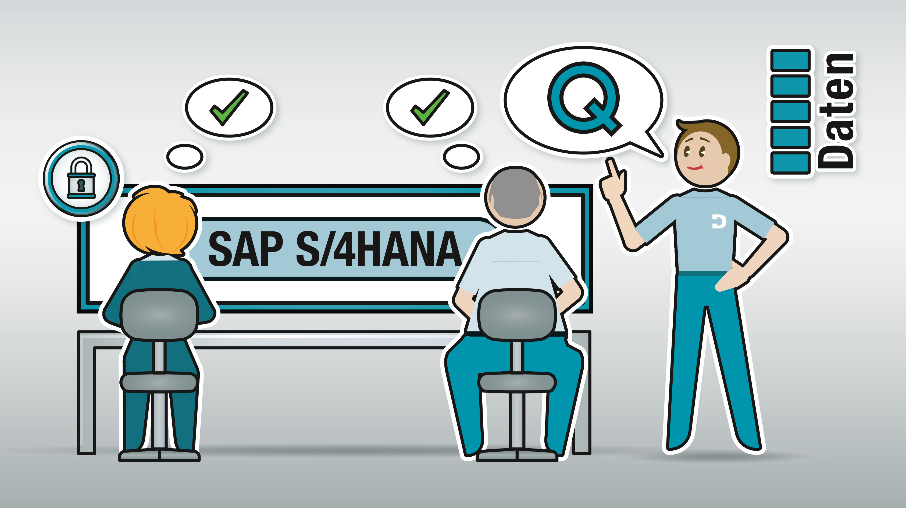
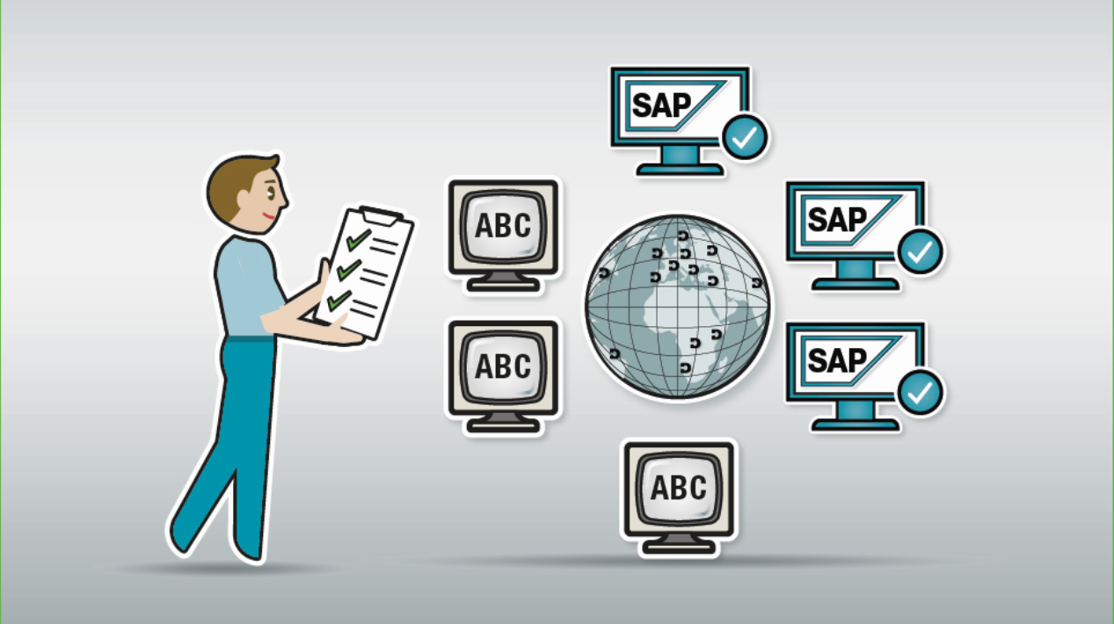
Summary of the main changes for the company as a whole at a glance (1/2)
Conversion of HOST and other systems to SAP
Working in an integrative system especially in turnover and inventory
Comprehensive transformation
Empowerment & training of
affected employees
Transition scenarios
Transfer of data from the old to the new world and vice versa

Slide 22

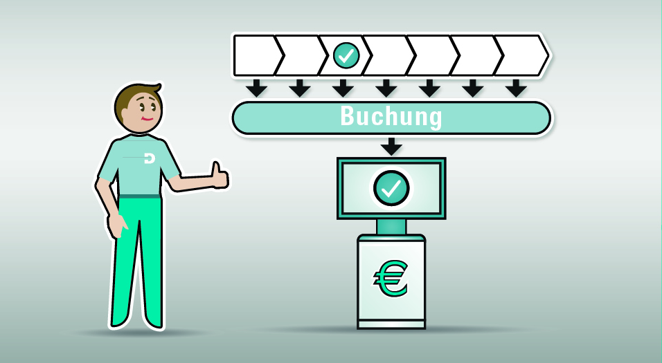

Summary of the main changes for the company as a whole at a glance (2/2)
New operating model: intercompany sales
Change from providing towards purchase / sale
Integrated mass
and value flows
Every action in the production triggers a posting
"Overall process" understanding (end-to-end)
"Link" of a consistent overall process
Posting

Slide 23
The change: Benefits & efforts - What's in it for me?

Slide 24





Key messages
Stakeholder overview
… in future, my team and I are working with an integrated system and process landscape plus we are monitoring our data in real time. That’s considerably boost the group’s efficiency, speed and transparency. This enables us to make a sustainable contribution to the growth of the overall company value.
… we gain a mutual „data backbone”, which provides data in realtime. So, we all talk about the „same“ and can now interact more smoothly – right across functional limits and national borders.
… everything is "interconnected“ – Each one of my actions triggers off a booking. My entries for quantity and value flow are made automatically, which saves time and effort for me. Transparency is increased, as I now make analyses in real time. I therefore identify potential errors faster.
… I am working connected with my colleagues from all our locations at the same time in a state of the art system landscape, which connects people, data, systems and processes in an optimal way. In this way, we are ready for the digital future.
(Top) Management
Affected managers
Affected employees
All employees

Slide 25
synapsis: Top 20 Added Values for DRÄXLMAIER (1/2)
Profitability / Quality / Operational Excellence
1. Increased efficiency, speed and transparency, particularly for indirect costs. High degree of integration and automation, less manual work and improved reporting/analysis.
2. Integration of mass and value flows in real-time.
3. Support for global growth by way of high degree of harmonization of processes and standardization of systems (Template approach & use of SAP Standard).
4. Use of “integrated corporate planning” for all functions.
5. Uniform master and transactional data while at the same time considerably reduced inter-faces between the applications (example: KDD01: one consistent number from engineering to EOL).
6. Process and System Landscape is at the state of the art (“globally uniform integrated Process and System Landscape”).
7. Availability of standard automotive functionalities and continual further development of the system (by SAP AG).
8. One truth, one value: transparency and efficiency in financial planning and reporting.
9. Synergies between Series and Non Series processes by integrating Non Series (NSL) in the DRÄXLMAIER Global Template (DGT).
10. Uniform system in the SEP phases P, V, S as well as CKD and spare parts processes.
11. Drastically improvement Runtime of MRP run.

Slide 26
synapsis: Top 20 Added Values for DRÄXLMAIER (2/2)
Innovation
Focus on the Employee
Sustainability
12. Precondition for digitalization, Big Data Analysis, IoT, DRÄXLMAIER data-backbone.
13. Collaboration at the interfaces to customers and suppliers.
14. Allow usage of mobile devices for more flexibility of affected user groups.
15. Integration of cloud applications, for example Ariba or IBP.
16. High availability and shorter training periods for new employees/ external service providers worldwide due to commercially available IT Architecture. More appeal as an employer.
17. SAP Fiori apps for improvement usability and efficiency.
18. SAP provides an international and multilingual solution for most of DRÄXLMAIER presented countries.
19. S/4HANA Enterprise Management: future of the
DRÄXLMAIER IT Architecture is guaranteed.
20. Precondition for make or buy decisions, for example hosting systems or application lifecycle maintenance (ALM).

Slide 27
Further information

Slide 28





synapsis End User Training Concept
Key elements of the training program
End User training conduction
Business Go-Live
OCM as prerequisite
SAP Basics
Role-based process & transaction training
A-day-in-the-life Simulation („gameplay“)
Post go-live training
  synapsis basis information
  Change Management and Training communication
  Business process overviews
  SAP system navigation
  Training format:
  Web-based training (eLearning)
  Facts, concepts, terms, process flows
  Process/ task teaching
  Hands-on exercises
  Training format: (virtual) classroom trainings and eLearnings
  Employees practice their critical operational day-to-day tasks in a real time system environment incl. data and equipment for a more efficient qualification prior to the go-live
  Hypercare support & on-the-job coaching at the workplace by Process Partners
  Training material (SAP Enable Now)
Coming soon
  Digital Adoption Platform:
  to guide users through the software in productive environment
synapsis Process Partners support synapsis with a variety of project tasks and deliver training activities.
They build up synapsis expertise and are essential for the sustainable success of the program.
Notes:
Formal training builds on OCM activities already addressing users’ information and learning needs.
Users enter training with a sufficient level of understanding of “how” their jobs are changing in order to focus on “what” they need to do.

Slide 29
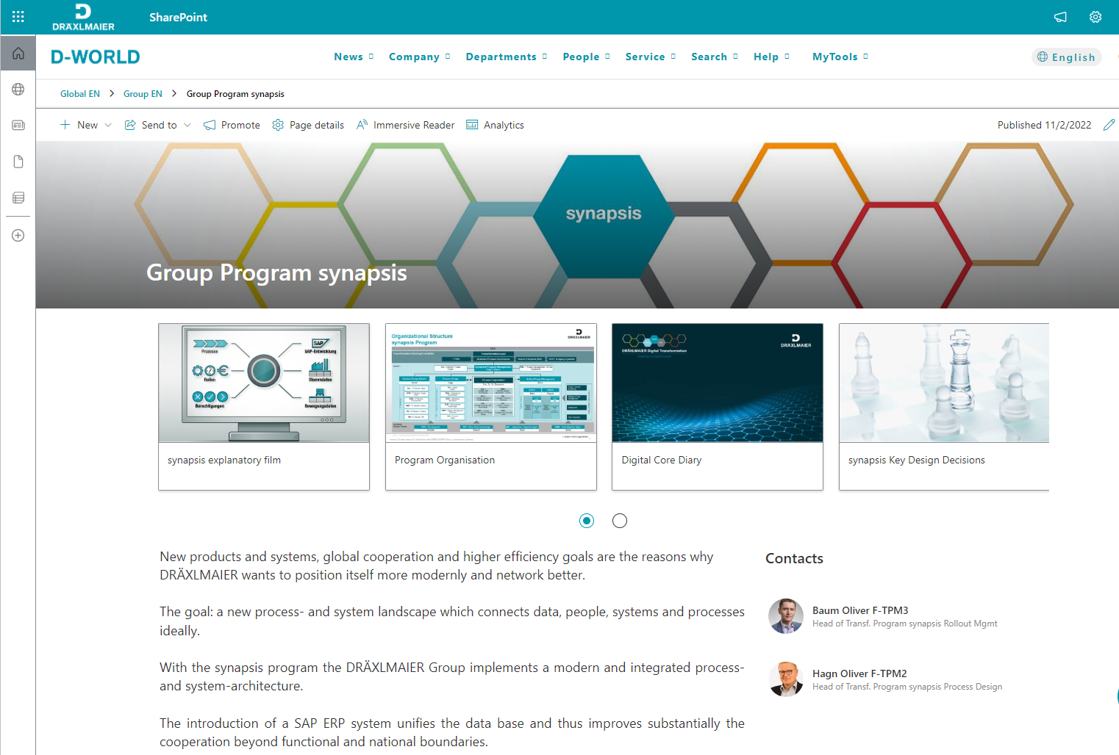
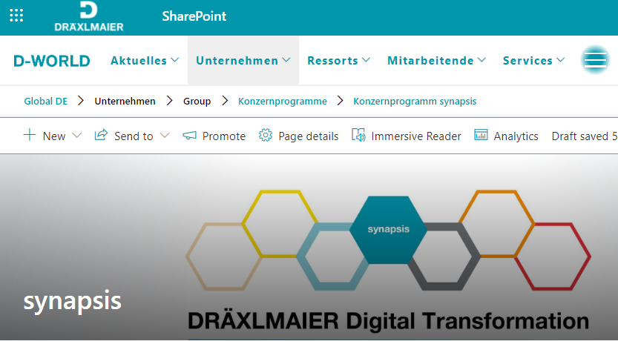
Good to know
Link collection
…useful explanatory videos
… all global changes
Here we can find …
D-WORLD group program synapsis
… the synapsis Diary
… the Program Organization
… impacts & benefits
… and a lot of further interesting information

Slide 30
BACK UP

Slide 31



The S/4HANA introduction entails multi-dimensional changes...
STRATEGIC CHANGE
Harness modern technologies – view change as opportunity
PROCESS-RELATED CHANGE
Standardise and optimise business processes – promote end-to-end understanding
ORGANISATIONAL CHANGE
Develop competencies – Adjust management and working methods
SYSTEM-RELATED CHANGE
Analyse system landscape – define interfaces – implement SAP S/4HANA system

Slide 32
synapsis value map across the house of processes
target based management
rule based management
Process harmonization and standardization in the SAP system deliver benefit potentials across regions and pre-series, series and non-series products.
financial planning
reporting
integr. corporate planning
customs compliance
tax compliance
segregation
of duties
quality auditing
manage marketable ideas and innovations
creation of products
implementation and realization of products
resource management
single material number concept
manufacturing change order
financial management
daily MRP
inventory management
information technology management
capacity
planning
traceability
digital production twin (BoM/routing)
FMEA
integrated maintenance
integr. packaging planning
return. packaging accounts
customs management
sampling folder management
preference calculation
transport
planning
yard
management
complaint handling
improved master data
modern and multi-lingual UI
Enable Now
purchasing volumes
intercompany processes
invoice verification
financial reporting
future-proof IT architecture
reduction of applications & IF
operations (hosting, ALM)
supplier evaluation
period end closing
mgmt. of roles & authorizations
usage of mobile devices

