Slide 1
Concept result and deviation control synapsis - DRAFT
Result management of legal units and formation of IC transfer prices in the new business model due to the introduction of an integrated flow of quantities and values

Slide 2
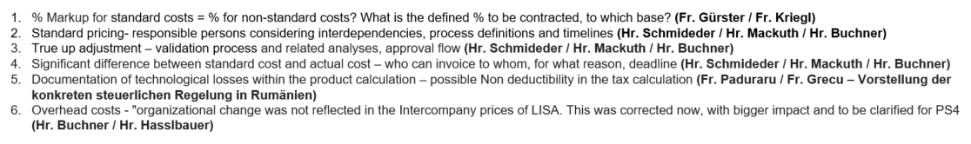
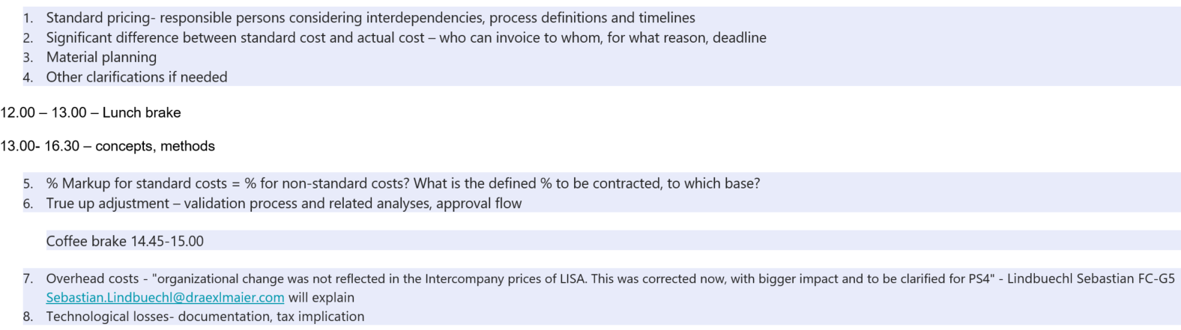
E-Mail Hammerl
Einladung Paduraru
Schmideder/Mackuth/Buchner
Schmideder/Mackuth
Buchner → Planung allgemein
Gürster/Kriegl
Mackuth/Schmideder/Buchner
Hasslbauer/Buchner/Lindbüchel → Planung/Ist
Paduraru/Grecu

Slide 3
Agenda
1.
Overview: Governance – Processes – Collaboration Model
2.
Standard (manufacturing) costs – guidelines
3.
Result management of legal units – calculation of IC transfer pricing – plant controlling

Slide 4
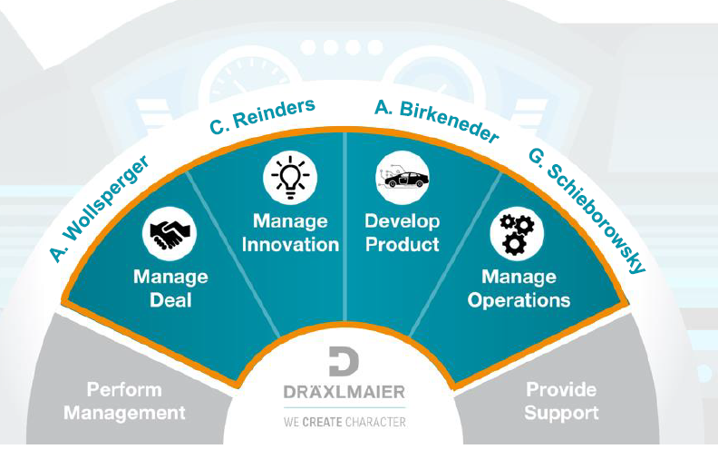
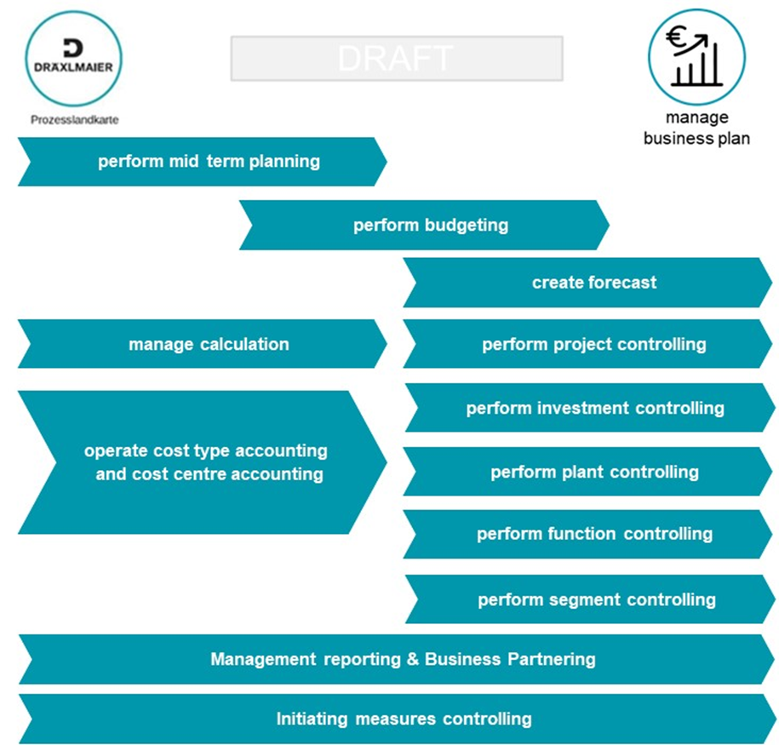
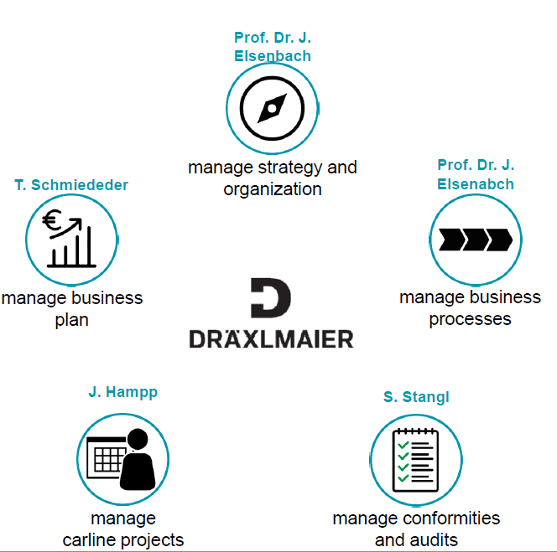
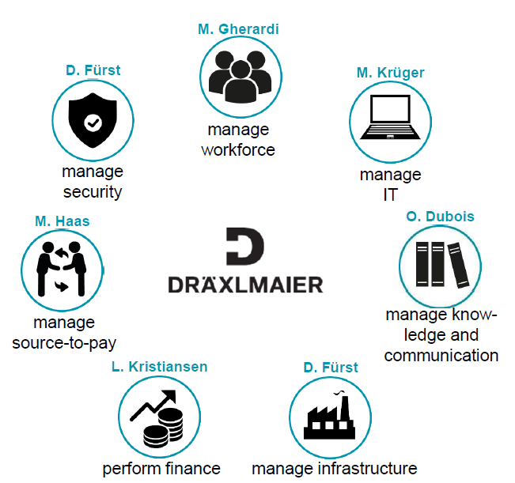
Process landscape 2.0 – controlling processe “manage business plan”

Slide 5

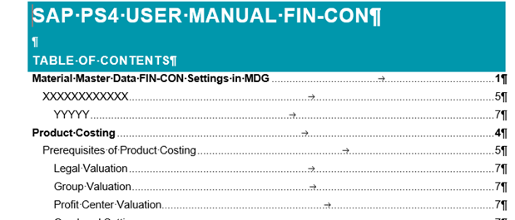

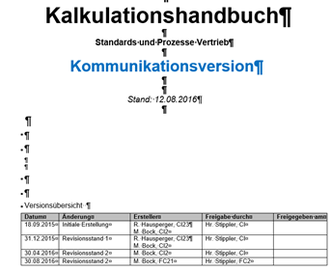
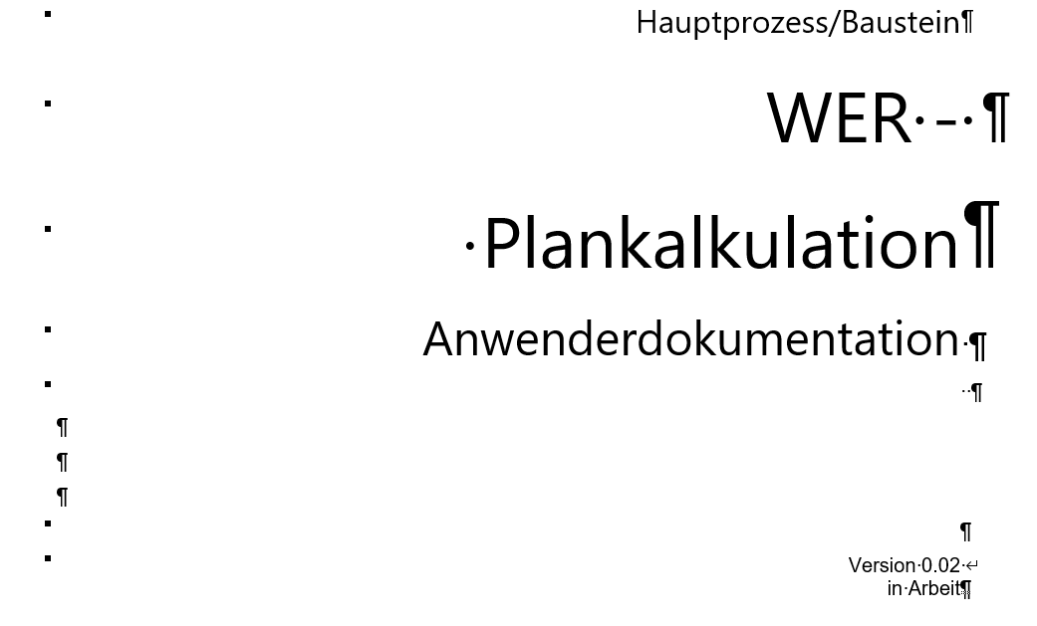


Process landscape 2.0 – documentation – guidelines – training …
Cost type accounting
Cost center accounting
Calculation
Contribution Margin
What costs have been incurred?
Where did the costs accrue?
For which product did the costs accrue?
What period success was achieved?
Operate cost type accounting
and cost center accounting
Calculation managen
Guideline / Standard / Directive worldwide for the DRX Group
Work instructions (user manual)
How do I carry out the work steps and when
Training documents for systems and process
SAP training, …

Slide 6
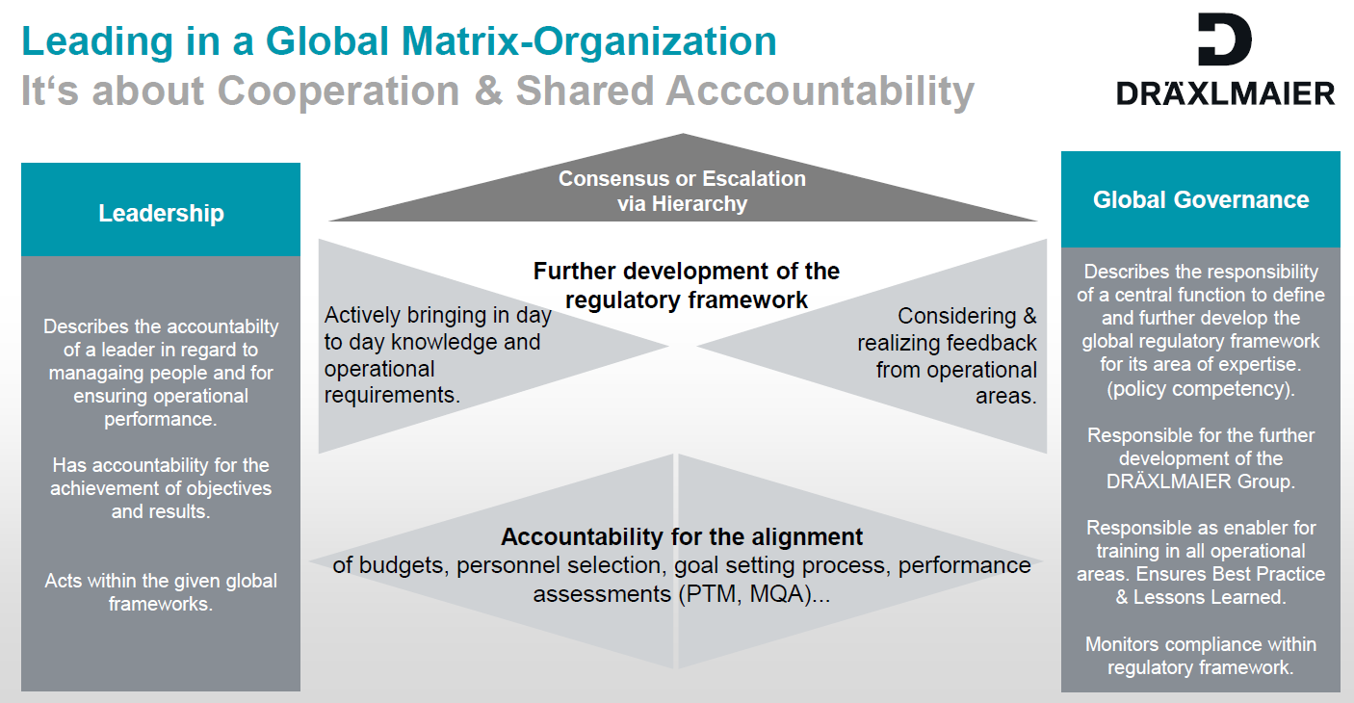
Tasks and cooperation model - local controlling and governance/standards

Slide 7
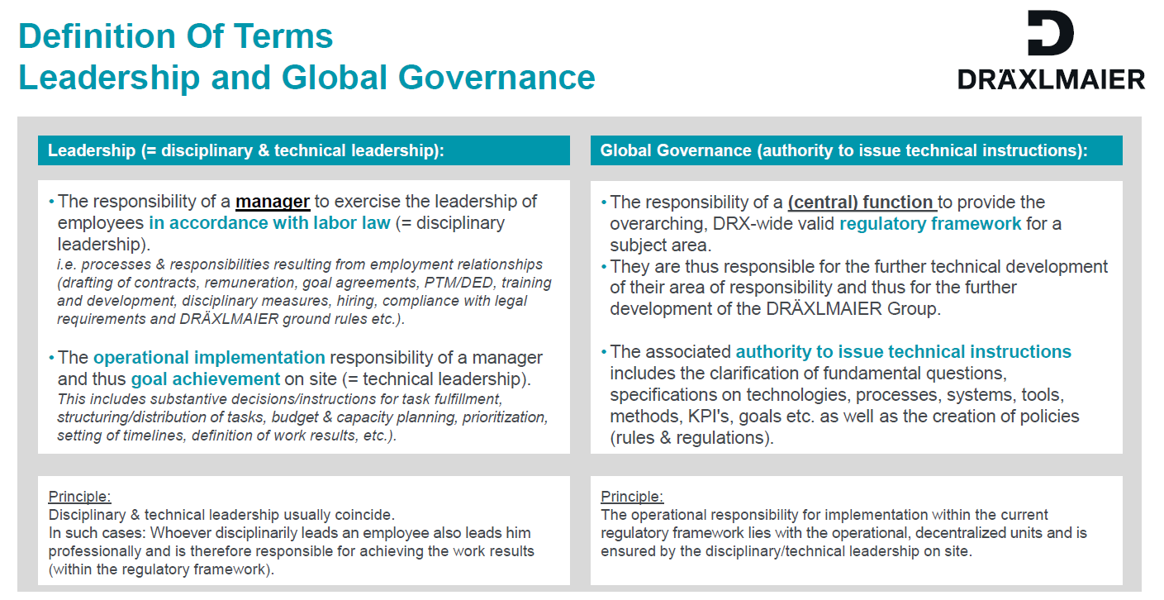
Tasks and cooperation model - local controlling and governance/standards
HR - Intranet: Presentation „Lead in the matrix“

Slide 8
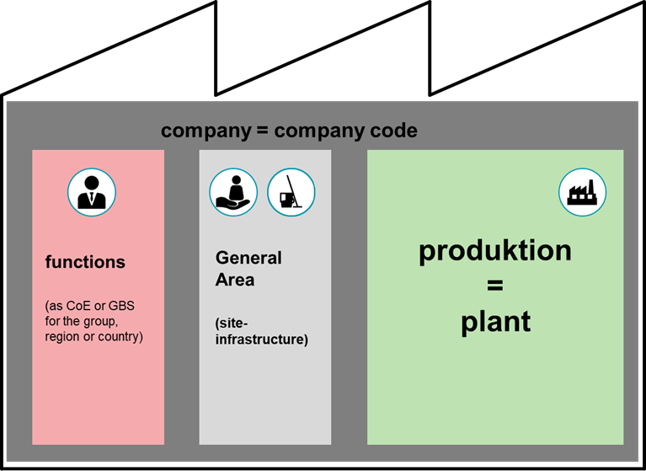
Holistic view of the synapsis changes
LE 1
Change from provision to sale
perspectives
LE 2
Group / legal entities
Controlling
(Budget / Ist / Forecast / …)
inventory valuation
LE 3
EBIT-Margin / Tax
Change from provision to sale
contracts
…

Slide 9

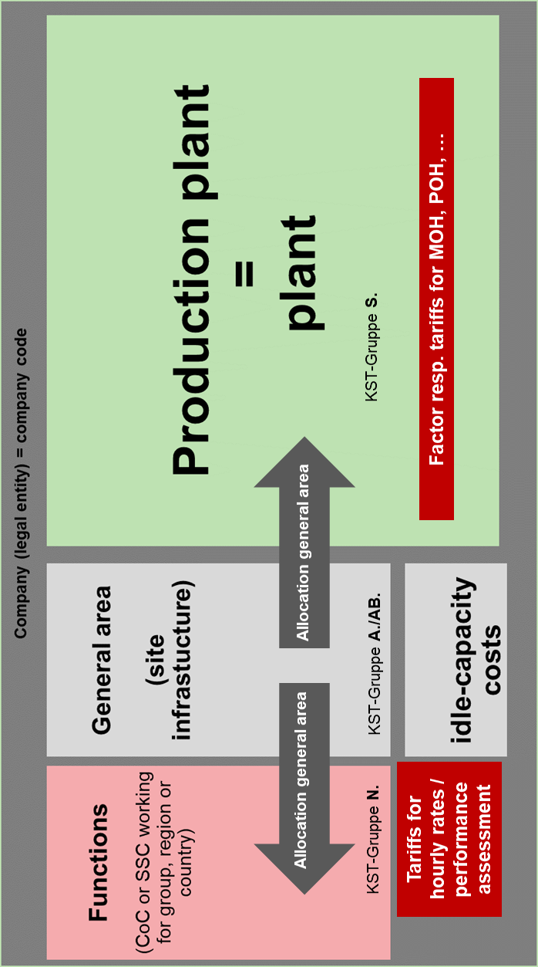
Tasks and cooperation model - local controlling and governance/standards
Tasks / Topics
Local Controller - Governance / Standard
Cost accounting:
Cost center / - hierachie
allocationen
tariffs
Local controlling
FC-G2 + FC-O Hasslbauer / Buchner / …
Product:
standard manufacturing cost
Inventory calculation, …
PRnew
FC-G2 + FC-M + FC- O Hausperger / Hasslbauer / Buchner / …
Plant steering:
Deviation-analysis
ppa – reporting / measures
…
FC-O Hirmer / Buchner + FC-G2/3 Hasslbauer, Kriegl, …
functionscontrolling
Functionscontrolling central / FC-G2 / …

Slide 10
Standard Hierarchy I – General Area

Slide 11
Standard Hierarchy II – Product Costs

Slide 12
Standard Hierarchy III – General Overhead

Slide 13
PS4 Allocation Concept

Slide 14
Inventory valuation for RHB, work in progress and finished goods
Hassl-bauer
C-System / HOST
Material company
Owners of RHB, work in progress and finished products
Evaluation in the material company
Tariff determination for inventory valuation in the materials company according to the accounting manual
…
IC-invoicing
service companies (LISA, FDKG, …)
Production costs (transport costs, transport containers, factory support, …)
…
A-System
new: production company
Owners of RHB, work in progress and finished products
Evaluation in the production company
Tariff determination for inventory valuation in the materials company according to the accounting manual
new: IC-invoicing
service companies (LISA, FDKG, …)
Production "overhead" companies e.g. DIS, EKB (transport, transport containers, factory support, operations management, ...) to the respective production company
analogous to the other components for MGK (purchasing, ...), … from the respective DRX companies
LISA
DPL
EKB
…
IC-invoicing
(DL, Transporte, …)
EKB
DAR
DIS
DAR
DIS
…
LISA
Owner
Owner
…

Slide 15
ICO Invoicing follows the Production Process

Slide 16
ICO Invoicing Operations OH

Slide 17
Cost Center Invoicing HQ and Regional

Slide 18
Result management of legal units - calculation of IC transfer pricing
C-System / HOST
Individual invoices
PS – Billing of projects (development, start-up, ...)
Contracts (e.g. rental, outsourced OH KST, various central functions, etc.)
Payroll Accounting (Cost-Plus)
Segmented P&L (included all costs)
External costs
5% mark-up on all external cost components
A-System
Individual invoices
PS – Billing of projects (development, start-up, ...)
Contracts (e.g. rental, outsourced OH KST, various central functions, etc.)
NEW: to define and design additional settlements, as they are not part of the standard (production) costs (e.g. relocations, restructurings, ...)
NEW: Standard cost + margin per product
EMEA region has introduced the buying and selling principle between companies
Defined markup per product

Slide 19
Standardherstellkosten

Slide 20
calculation – standard (manufacturing) costs – Draft
uses the DRX-uniform costing sheet
The standard cost of goods manufactured is calculated once a year on January 1 of each year. The calculated standard cost of goods manufactured is then generally valid from January 1 - December 31. Exceptions:
Changes of products in the current year (new material no.)
New products in the current year (first time costing)
Recalculation or changes of standard cost of goods manufactured during the year are allowed only,
if the standard cost of goods manufactured is incorrect
if there are massive price increases (material, tariffs) in the current business year
This recalculation or changes must be requested from FC-G2, will then be decided on a case-by-case basis and then releasedThe application of the changed or new standard cost of goods manufactured always takes place from the next full month, for example August 1 - December 31 of the year in question.

Slide 21
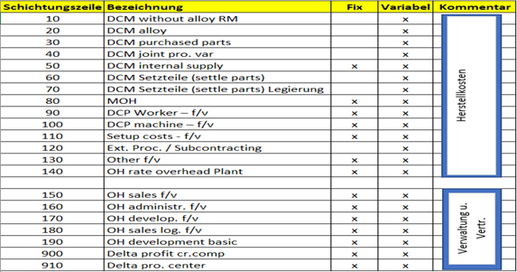
calculation – standard (manufacturing) costs – Draft

Slide 22
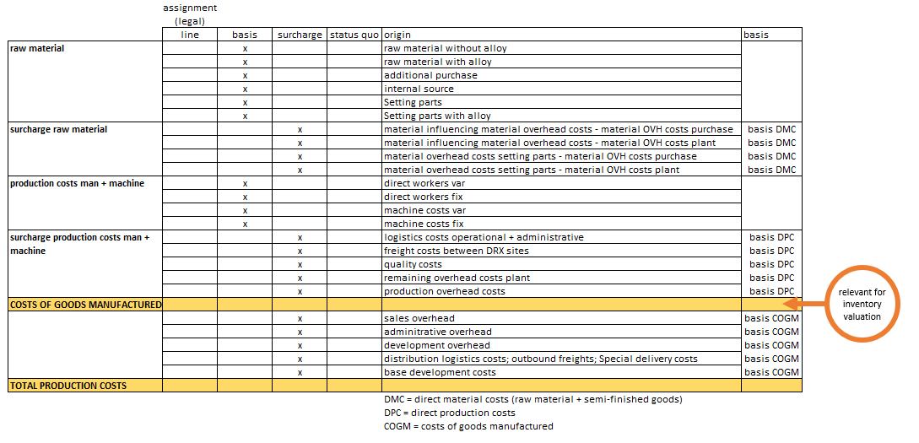
calculation – standard (manufacturing) costs – Draft

Slide 23
calculation – standard (manufacturing) costs – Draft
the standard (manufacturing) costs are always determined per LE and take place in local currency. (Standard cost of goods manufactured for a legal entity also in group currency →Translation always takes place at the planned exchange rate)
the standardard cost of goods manufactured (simplified) is determined:
The material usage per product is determined from the quantity specification from the bill of materials (BOM) and the respective valid info rate or moving average of the input material. For internal components or deliveries always the "S-price". The production costs per product are calculated from the quantity specification from the routing (BOP) multiplied by the planned prices of the respective work center or cost center.
Always select the correct explosion date for the BOMs (1.1.) and the valuation date (1.1.), e.g. BOP valid 1.1 , PT valid 1.1.
plant

Slide 24
calculation – standard (manufacturing) costs – Draft
The standard manufacturing costs (simplified) are determined as follows:
Planned employment maps the sales planning, i.e. the planned sales quantities for the respective products or series. This approach applies to all cost centers or work centers.
The material planning (2023) is derived from the average vehicle for the respective location and is then supplemented by the IC purchases (as the penultimate step in the income statement planning)
The planned employment (capacity) for functions (“non-series”) (e.g. development or IT (programming) cost centers) corresponds to the planned productive employee hours, usually excluding managers and assistants. The planned hours are determined on the basis of the planned employees
The surcharge rates with the respective plan rates on the respective reference values
These rules also apply to the other areas (toolmaking, special machine construction, production equipment construction, ...)
Buchner
Buchner
Hassl-bauer

Slide 25
General Overhead – Hourly Rate Calculation I

Slide 26
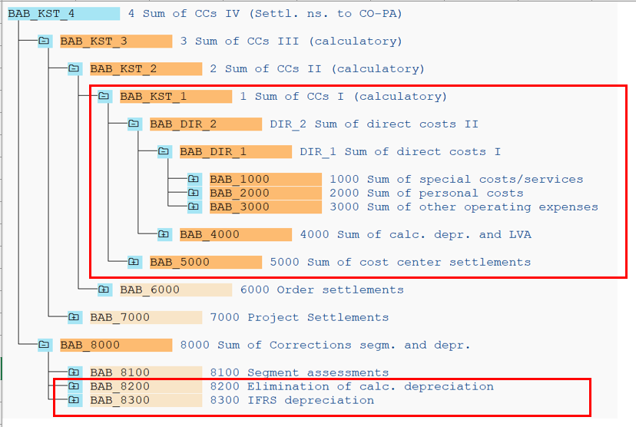
General Overhead – Hourly Rate Calculation II

Slide 27
Planung principles for budget planning 2023ff PS4 companies (DPL, DHG, DAR)
task.
doing
Minutes and material plan datas from sales CO
Plant CO include into planning
CC planning based on premise group, sales, functions
DCP + OH cc planning as usual
Done by Plant CO
TEM: calculate % for splitting OH cc MOH and POH per segment
basic for Operations and group planning
Split total cost + material into all functions and segment costs
remark: no splitting cost between ramp up and series costs needed!
Done by Plant CO
Interco with strategy carrier
Planning balance sheet as usual but with effects property materials
Done by Plant CO
Interco with strategy carrier

Slide 28
Armth´s length EBIT margin for each LE - calculation of IC prices

Slide 29

Standard manufacturing costs – IC prices - Result control of LE
standard manufacturing costs + margin
non-standard manufacturing costs
other revenues (OH-functions, …)
additionally: true up - correction year end

Slide 30

Standard manufacturing costs – IC prices - Result control of LE
Revenues for outsourced OH functions, rental, central functions, ...
Ordering company
Revenues from development projects, IT projects, ... for central functions
Ordering company
New: Start-up costs via project accounting
Strategy carrier
Non-standard manufacturing costs
New: Restructuring; Inventory differences, scrapping
Strategy carrier
New: Crises (Corona, Ukraine); strat. Utilization; → Individual decision.
Tbd. in individual cases
New: Relocation via project accounting
Tbd. in individual cases
Price deviation (material, tariffs)
valuation-relevant yes/no Tolerance Analysis and approval processes
Adjust inventory rating and IC price
Employment deviation (planned actual)
Planned volume is exceeded or undercut, Analysis and approval processes
Direct billing to the Strategy carrier
Standard manufacturing costs + margin
Consumption variance (costs, personnel)
Reduced and over-consumption caused by the contract manufacturer
covered by margin
Production ramp-up
HK+Marge
New: possibly one-time compensation calculation at the end of the year (result)
Strategy carrier

Slide 31
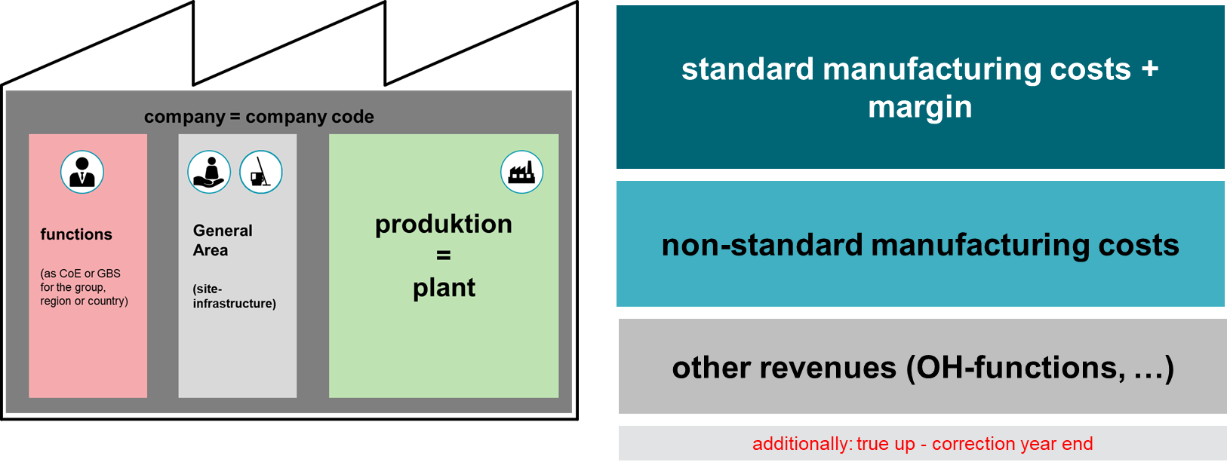
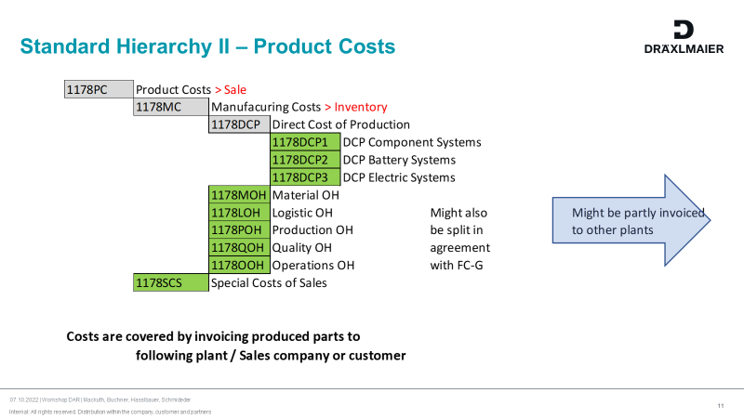
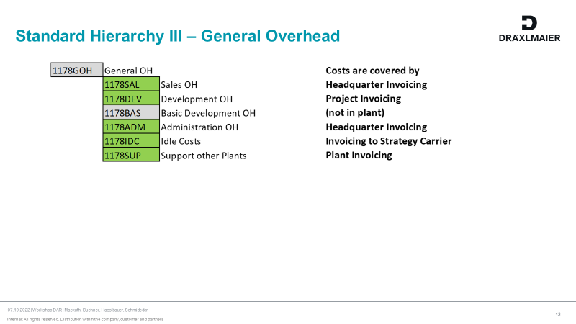
Armth´s length EBIT margin for each LE - calculation of IC prices
(→ topic)
(→ recipient)
Revenues for outsourced OH functions, rental, central functions, ...
Ordering company
Revenues from development projects, IT projects, ... for central functions
Ordering company
Hassl-bauer

Slide 32
Cost Center Invoicing HQ and Regional

Slide 33
Armth´s length EBIT margin for each LE - calculation of IC prices
(→ topic)
(→ recipient)
New: ramp-up costs via project accounting
Strategy carrier
Buchner
Non-standard manufacturing costs
New: Restructuring; Inventory differences, scrapping
Strategy carrier
Buchner
New: Crises (Corona, Ukraine); strat. Utilization; → individual decision
tbd. in individual cases
Buchner
New: Relocation via project accounting (W-projects)
tbd. in individual cases
Buchner
Hassl-bauer

Slide 34
Displaying of ramp-up costs Operations in SAP PS4 (Production/Logistics/Quality)

Slide 35
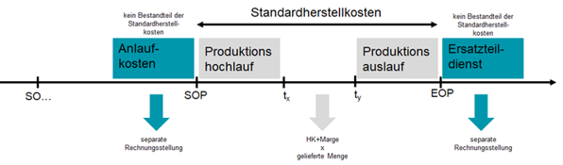
Ramp-up costs
not part of standard production costs
Standard production costs
not part of standard production costs
Ramp-up
costs
Production ramp-up
Production ramp-down
Spare Part service
Seperation via WBS element
production costs + margin
x
delivered qty
Seperate
invoicing

Slide 36
Target situation Premisses displaying of ramp-up costs in PS4 (draft)
Ramp-up costs of CCs and production orders are to be displayed on a WBS element.
Ramp-up costs include:
Production orders for project development (process_product_stock)
Ramp-up costs have to be mapped to a WBS element for E-projects until 1 month before SOP
Dispatch from warehouse/ scrapping to a WBS element via moving type 221 with assignment to a consumption account (sample, airbagtest) or scrapping of finished products out of the warehouse via EWM with moving type 551 (confirmed by BPM workflow) that are produced within the first 3 months after SOP (process to be clarified/ structured)
Dispatch of material without production order or production cost relation within the first 3 months after SOP
The balance of a CC for production step 3-5 is part of the ramp-up costs until 1 month before SOP and therefore has to be mapped to a WBS element for E-projects
=> If the SOP changes in actual compared to the planned date, this has to be adopted in the cost assignment.
Ramp-up costs DON‘T include:
Production orders for the creation of stocks and first deliveries before SOP
Costs for the new construction of a plant „on the green field“ => high remaining costs
Costs on a production order for project development (process and product)
These production orders have to be settled to WBS elements for S-projects after the first 3 months after SOP (development projects end after the first 3 months after SOP) until EOP
8. Open: Displaying ramp-up/ ramp-down costs caused by relocations
9. Open: SOP achieved but very flat start-up curve (Batterie PO426B und MBPH3 AMG)

Slide 37
Production orders Part of the ramp-up costs
→ 1. Production orders for project development (Process und Product) after request
Production control opens production orders with production order type ZP10 or ZP12 (includes settlement rule to WBS element and work package PD04)
Apart from the dispatched material, also the surcharges, the production output man/ machine and the produced good are to be settled to the WBS element.
On the WBS element finally the variance (Material, surcharges, production output man/ machine vs. produced and delivered material (standard price * produced qty)) is shown.
→ 2. Dispatch from warehouse or scrapping of finished goods in warehouse that are scrapped within the first 3 months after SOP
→ 3. Dispatch of material without production order or production cost relation within the first 3 months after SOP

Slide 38
Balance of a CC for production step 3-5 Part of the ramp-up costs
→ 4. The balance of a CC for production step 3-5 is part of the ramp-up costs until SOP – 1 month
The balance of these CCs
Cost Center PS 1-2 are NOT part of the ramp-up costs
Cost Center PS 3-5 are ramp-up costs until SOP – 1 month
The settlement of the balance is done
During monthend closing via plan and actual allocation (cycle N) with a new secondary cost element 81210137 Assessm. Ramp-up costs to WBS element with work package PD04
If the SOP changes in actual compared to the planned date, the allocation has to be adopted accordingly

Slide 39
Cost Center PS 3 - 5 Part of ramp-up costs | plan tariff for ramp-up
In the following you find 2 examples:
→ 4. DPC-tariffs:
Example 1: MTP 2023 – SOP May 2023:
Plan minutes available from May 2023 on, therefore the automated tariff calculation in SAP is possible for the months May to Dec 2023
Manual upload of the BER tariff (SAP TA KP26) for the ramp-up phase Jan to April 2023
Example 2: MTP 2023 – SOP Jan 2024:
No plan minutes available for 2023, but already plan costs man and machine; therefore the tariff of the BEP planning is to be uploaded for 2023 (SAP TA KP26).

Slide 40
Premisses displaying ramp-up in A-system
Overhead surcharges for the standard calculation during ramp-up:
Special case 1: Ramp-up in existing plant in same segment:
MTP 2023 SOP – May 2023: calculated overhead surcharges (MOH and POH) are valid also for the ramp-up phase Jan to April 2023
MTP 2023 SOP – Jan 2024: calculated overhead surcharges (MOH and POH) are valid also for the ramp-up phase 2023
Special case 2: Ramp-up in existing plant but different segment :
MTP 2023 SOP – May 2023 : calculated overhead surcharges MOH are valid also for the ramp-up phase 2023
Remark: the POH from the BEP is to enter in SAP for 2023
MTP 2023 SOP – Jan 2024 : calculated overhead surcharges MOH are valid also for the ramp-up phase 2023
Remark: the POH from the BEP is to enter in SAP for 2023
Special case 3: Ramp-up in new location
Overhead surcharges from BEP have to be used; if they don‘t exist = defined factor from Operations => plant buildup project needs to be created and the remaining costs of the overhead cost centers have to be settled

Slide 41
Production orders Not part of ramp-up costs
→ 5. Production orders for the creation of stocks and first deliveries before SOP
Production control receives customer demands and creates production orders with order type ZP01 – ZP13 (w/o ZP10 + ZP12) (include settlement rule Material).
The overconsumption of the production order is not to be assigned to the ramp-up project!
Clarification with logistics how to distinguish between project and creation of stocks

Slide 42
Aligned process CC PS 3 – 5 Creation of allocation for actual and plan
Process for new creation:
Inclusion in CC creation process:
New process necessary if a new CC within range 43XXX – 45XXX is requested
FC-O1 informs:
FC-MX2 per segment for communication/creation WBS element (main project controller)
SAP FI-CO for creation CO allocation plan (version 0) and actual (cycle N) with valit-to-date SOP – 1 month (from MDM-list SOP/EOP)
Who monitors that the new cycles N are run? FC-O1 and FC-G2
How is the shift of SOP in actual to be handled?
Who gives the input? => sales controlling/ project controlling informs quarterly Susanne Heller FC-O1
Creation of new cost element 81210137 Uml. Anlaufkosten / Assessm. Ramp up costs by FC-G3
in SAP C02 + PS4
Assignment to BAB_5103
Creation in case of existing ramp-up
Creation of allocation actual and plan from 2023 on for existing ramp-ups (FC-M2 and FC-O1)

Slide 43
Standard manufacturing costs – IC prices - Result control of LE
Restructuring - DRAFT: (=Costs for personnel adjustment, e.g. social plans, ...) are not part of the stand manufacturing costs. Restructurings must be approved by the HGF. Restructuring must be planned or recorded separately and then billed to a strategy carrier(e.g. sales company).
Relocation (W-Projects) - DRAFT:
Relocation costs are incurred when machines, equipment and other manufacturing facilities are relocated from one location to another. Relocation costs are not part of standard manufacturing costs. The costs are to be planned and recorded in own projects (W-projects). To maintain and store appropriate billing regulations (strategy carrier or does the previous location bear if this creates advantages for the location (open spaces for new series) or does the new location bear if potential is raised there or ...? Relocation costs consist of costs for:
the dismantling of the plant at the old site,
the transport of the plant to the new location
and the construction of the plant at the new location further components (see W-Projects) (training of employees, business trips,...).
Exception: Capitalizable acquisition and production costs: In the case of cross-company relocations, the transport and assembly costs of plants/machines are capitalized at the recipient within the acquisition and production costs, so that the costs will be part of the standard manufacturing costs in the future.

Slide 44
Standard manufacturing costs – IC prices - Result control of LE
Inventory depreciation and inventory differences (special cases inventory) (changes) / scrapping - DRAFT: (= NCC, which business transactions are normal rejects (causing plant) and which events are due to changes made by the custome; separate billing and not part of standard manufacturing costs, revaluation differences, changes in inventory depreciation (in fixed assets and (quantitative) inventory differences at RHB, UFE and FE
Crises (Corona, Ukraine); strat. Utilization; individual decision: - DRAFT:
(= case-by-case decision, HGF decision necessary, decision yes/no not part of standard manufacturing costs)

Slide 45
Enter indirect employee on cost centers| Function Operations

Slide 46
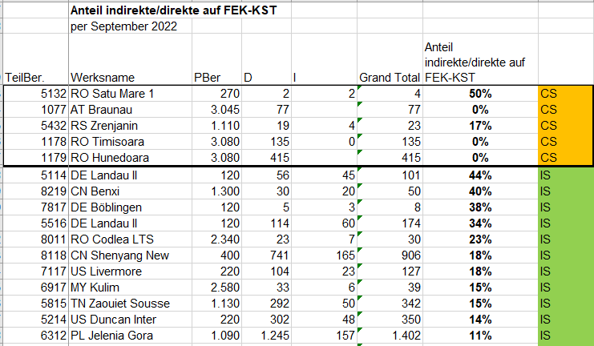
Actual situation no or less indirect employees are on DPC-cc in segment CS

Slide 47
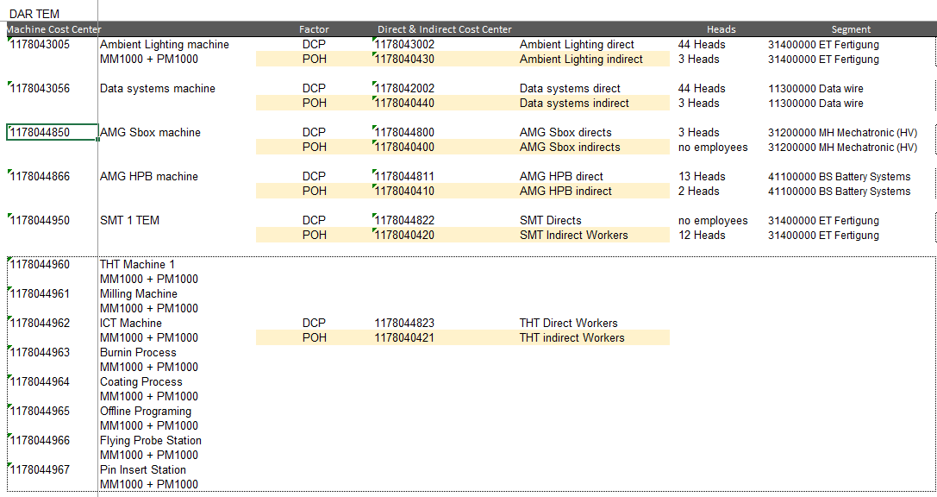
Actual situation CS | example DAR TEM pro production cell exists a cc for direct and indirects employees
SAP cc for indirect employee
Cc function not in part of SAP standard
Costs are part of POH
!

Slide 48
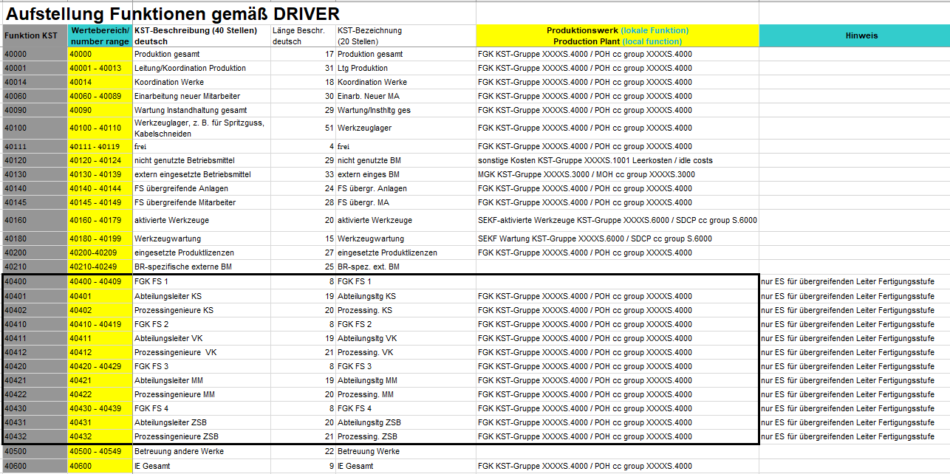
Target situation equal calculation manual DRX are only for following functions indirect employees in POH allowed:

Slide 49
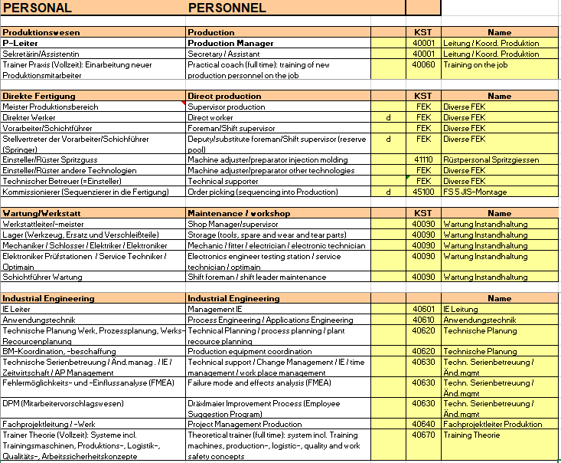
target-Situation Standard for assigning jobs on SAP CC
Further information are included in the file
O:\_DRXGroup\F\_F-Public\200_CO_Standards\Operations\Cost Centers_Kostenstellen

Slide 50
Next steps
Agreement from the members in CO-Standardteam, that the standard „entering employees on POH and DPC“ is also the use for plants in SAP PS4
Indirect employees like supervisor and shift supervisor are to enter on DPC cc
Cost for indirect employees are part of DPC
Inform the relevant plants:
=> DPL Braunau, DAR Timisoara, DAR Hunedoara, DHG Leipzig
Timeline for changing:
=> proposal FC-O: move the employees per 01.01.20023 in the current budget planning 2023

Slide 51
Armth´s length EBIT margin for each LE - calculation of IC prices
(→ topic)
(→ recipient)
Price deviation (material)
valuation-relevant yes/no Tolerance Analysis and approval processes
Adjust inventory rating and IC price
Buchner
Standard manufacturing costs + margin
Employment deviation (planned actual) (CC)
Planned volume is exceeded or undercut, Analysis and approval processes
Direct billing to the Strategy carrier
Buchner
Consumption variance (costs, personnel) (CC)
Reduced and over-consumption caused by the contract manufacturer
covered by margin
Buchner
Production ramp-up
HK+Marge
Buchner

Slide 52
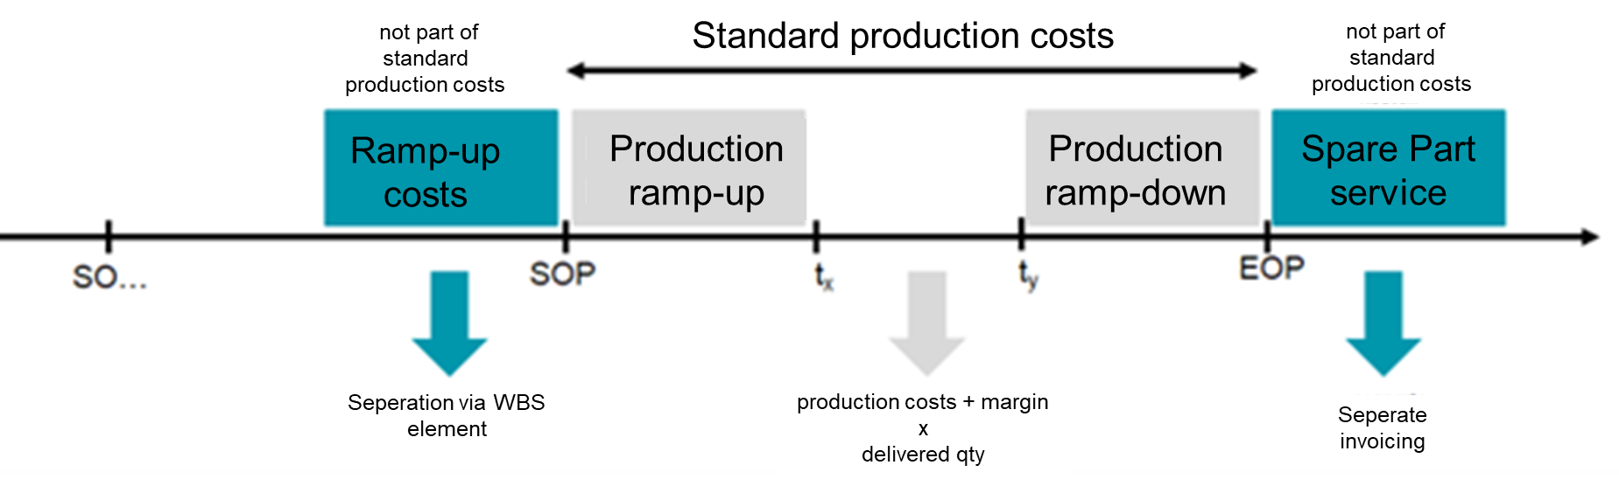
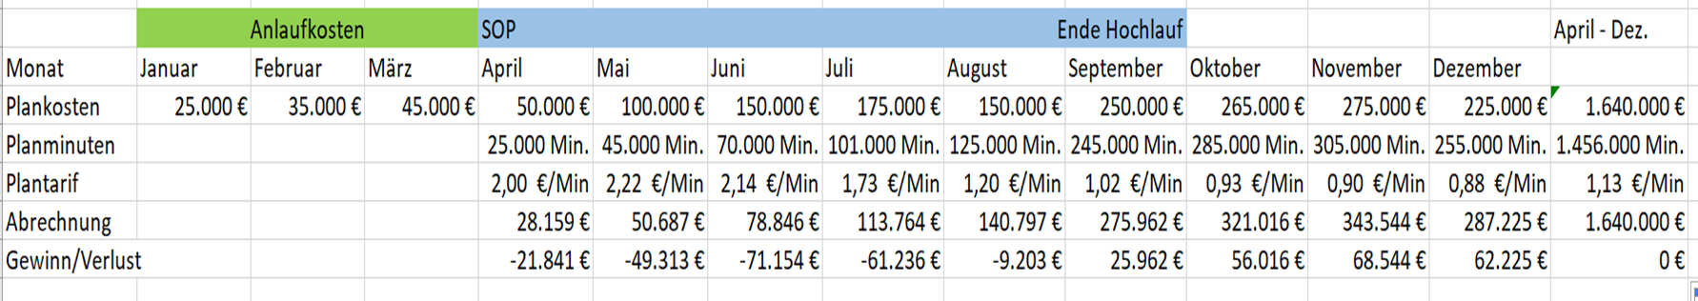
Standard manufacturing costs – IC prices - Result control of LE
Production Ramp-Up/Phase-Out - DRAFT: (= from SOP month until reached planned comb line or a maximum of 6 months after SOP (production ramp-up)); a maximum of 6 months before EOP to EOP (production phase-out) are part of the stand manufacturing costs
Question: How can the tariff be calculated in the start-up year or (factor from BEP planning = factor per cost center or, in special cases, from the WER = average factor across all cost centers)
Buchner

Slide 53
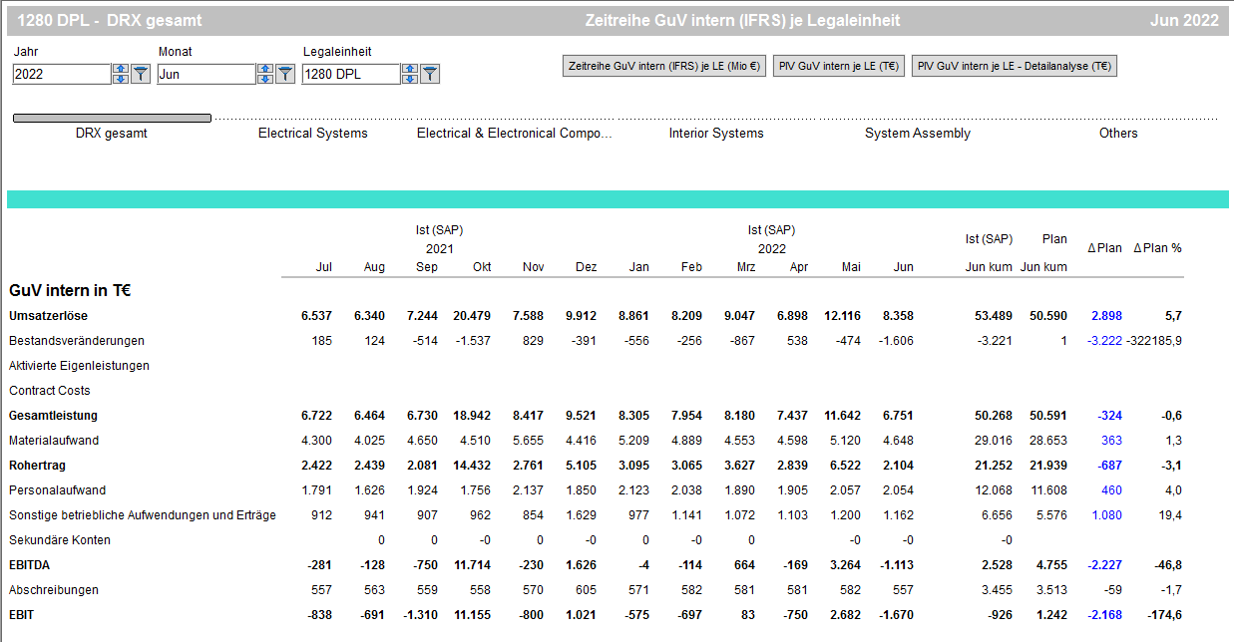
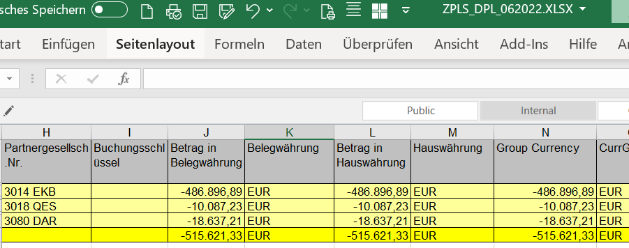
Standard manufacturing costs – IC prices - Result control of LE → Employment deviation
ZPLS Summe Juni 22 - DPL

Slide 54
Standard manufacturing costs – IC prices - Result control of LE
Revenues for outsourced OH functions, rental, central functions, ...
Ordering company
Revenues from development projects, IT projects, ... for central functions
Ordering company
New: Start-up costs via project accounting
Strategy carrier
Non-standard manufacturing costs
New: Restructuring; Inventory differences, scrapping
Strategy carrier
New: Crises (Corona, Ukraine); strat. Utilization; → Individual decision.
Tbd. in individual cases
New: Relocation via project accounting
Tbd. in individual cases
Price deviation (material, tariffs)
valuation-relevant yes/no Tolerance Analysis and approval processes
Adjust inventory rating and IC price
Employment deviation (planned actual)
Planned volume is exceeded or undercut, Analysis and approval processes
Direct billing to the Strategy carrier
Standard manufacturing costs + margin
Consumption variance (costs, personnel)
Reduced and over-consumption caused by the contract manufacturer
covered by margin
Production ramp-up
HK+Marge
New: possibly one-time compensation calculation at the end of the year (result)
Strategy carrier

Slide 55
Potential optimization from transfer pricing view
Step 1:
Price setting - Regular invoice (standard price)
Step 2:
Deviation analysis
Step 3:
Regular adaption of invoicing price
Step 4:
True up - correction year end II
Armth´s length EBIT margin for each entity
Price setting at the beginning of the year
Invoicing via regular SAP standard process
Budget / plan prices
Indentification of deviations
Analysis of actual figures
Result preview within the forecast timeline
Price adustment- Adaption of standard price for next quarters (ZPC0)
Invoicing of underutilisation (nichtaktivierungsfähige Kosten)
uncovered cost
Profits over benchmark -> payment to Germany
Losses -> compensation by Germany
Smaller amount due to price adaption during the year -> less risk!
10.12.2021 Synapsis – Concept of result steering from a transfer pricing perspective | Hammerl Wolfgang FX |
55

Slide 56
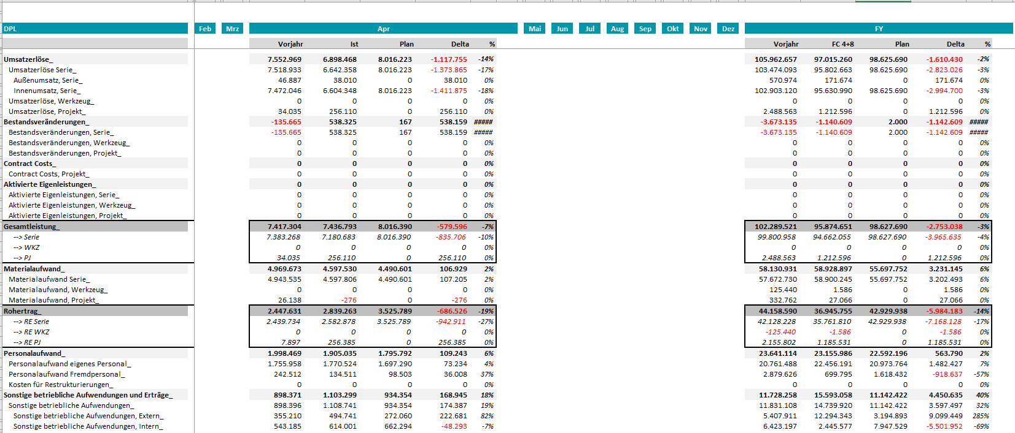
Plan-actual comparison from TM1for deviation identification – example DPL

Slide 57
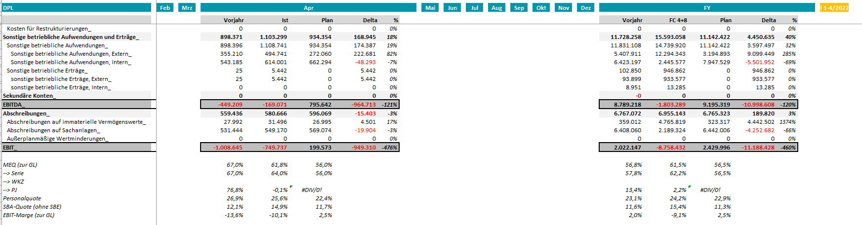
Plan-actual comparison from TM1for deviation identification – example DPL

Slide 58
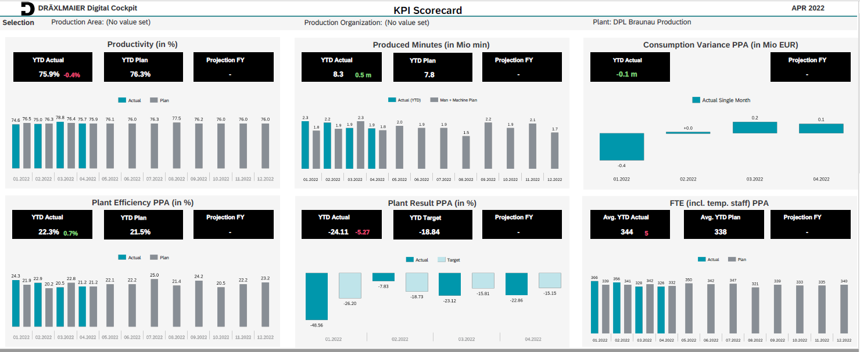
Further examples of analysis options (ppa, CO-PA in PS4, ...)
Other analysis options can also be used, for example plan/actual comparison KST, material analyses, ...

Slide 59
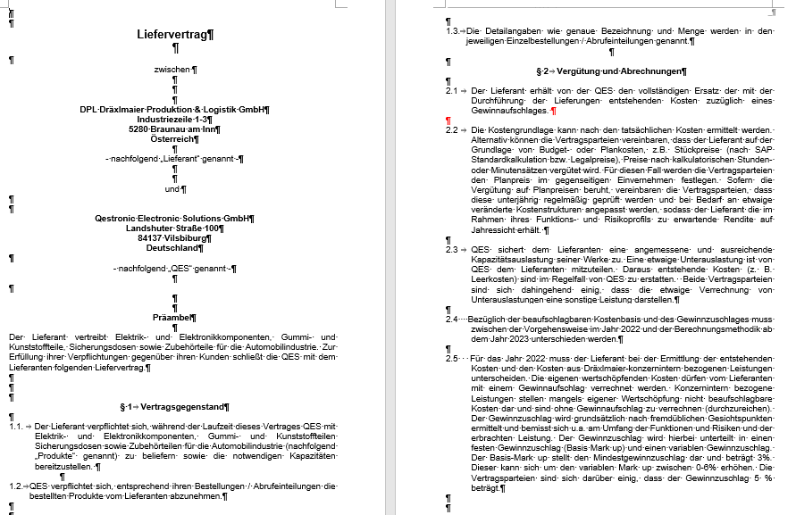
Update and change the existing contracts
Hammerl

