Slide 1
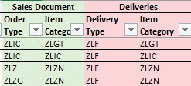
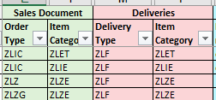
Bereitstellung Packmittel
SYNRE-798
Auftragstabelle
FAUF
Packmittel
Zpp_stock_packaging
MTS:
MTO:
Menge des FAUF
Fertigmaterial
VBAK-
AUART
VBAP-
PSTYV
Packvorschrift
Unterpackvorschrift
Bedarf pro Tag
Fertigmaterial
Erster Maschinen-
arbeitsplatz im Vorgang
PVB
Kalkulation
Umrechnung Bedarf FM zu Packmittel
PVB | Packmittel | Packmittel Bezeichnung | Tag | Menge | ME
PVB Gebäude 2 Ebene 2 (MTZ) | 190054438-001 | ID260; HOLZ EINWEGPALETTE; IPPC | 02.05.2021 | 5 | ST

Slide 2
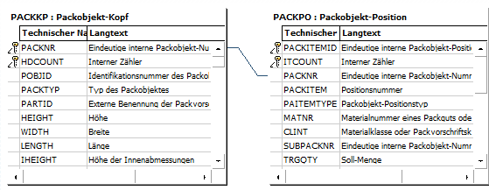
PACKKP Packobjekt-Kopf
PACKPO Packobjekt-PO
Packobjekt PACKKP-PACKNR 051MdaPK7kgS}4QEUiHhn0
Packvorschrift PACKKP-POBJID 2329
PObjPosId PACKKP-PACKITEMID 051MdaPK7kgS}4QEUiJBn0
Position PACKKP-PACKITEM 10
Packobjekt-Positionstyp PACKKP-PAITEMTYPE → P Verpackung
Material 599910210-001
Packobjekt PACKPO SUBPACKNR LEER
Soll-Menge PACKPO- TRGQTY 1
Packobjekt PACKKP-PACKNR 051MdaPK7kgS}4QEUiFBn0
Packvorschrift PACKKP-POBJID 2328
PObjPosId PACKKP-PACKITEMID 051MdaPK7kgS}4QEUiJhn0
Position PACKKP-PACKITEM 20
Packobjekt-Positionstyp PACKKP-PAITEMTYPE → I Mat
Material LEER
Packobjekt PACKPO SUBPACKNR 051MdaPK7kgS}4QEUiFBn0
Soll-Menge PACKPO- TRGQTY 48
PObjPosId PACKKP-PACKITEMID 051MdaPK7kgS}4QEUiGhn0
Position PACKKP-PACKITEM 10
Packobjekt-Positionstyp PACKKP-PAITEMTYPE → P Verpackung
Material 105059501-001
Packobjekt PACKPO SUBPACKNR LEER
Soll-Menge PACKPO- TRGQTY 1
PObjPosId PACKKP-PACKITEMID 051MdaPK7kgS}4QEUiHBn0
Position PACKKP-PACKITEM 20
Packobjekt-Positionstyp PACKKP-PAITEMTYPE → I Mat
Material 190052075-060
Packobjekt PACKPO SUBPACKNR LEER
Soll-Menge PACKPO- TRGQTY 500

Slide 3
Bereitstellung Packmittel
SYNRE-798
Torsten Pilz:
Replenishment of packaging is a purely manual process. Packaging is not part of BOM and booked in EWM on a dummy bin. Close to production are areas where the main packaging will be replenished by a manual Kanban system.
For low runner packaging we must do the replenishment Adhoc.
Report needed based on the production orders which is showing the information from the packaging instructions and also the workcenters. So in the report it should be possible to select FAUF´s for a specific time (e.g. open FAUF´s for next day) and as result is showing a summarized list of packaging material (based on the pack instructions related to this FAUFs) grouped by production areas/workcenters.

Slide 4
