Slide 1
Issue: Create Picking List
For Packaging Material
To Production Side
(PSA)

Slide 2
Master Data
1. Reasons for Make-to-Schedule (MTS) or Make-to-Order (MTO)
Different Packaging
Reserve Parts for Intercompany (e.g. HUN)
Different Lasering
Set correct „Item Category“ in
SD-Scheduling Agreement

Slide 3

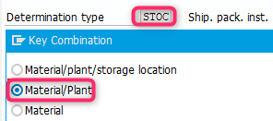
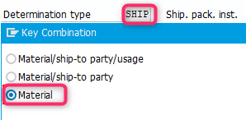
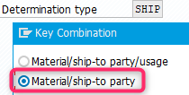


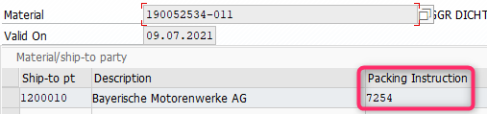
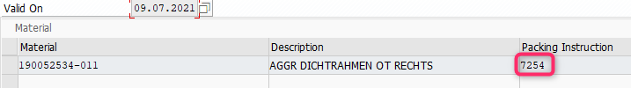
Master Data
2. How does SAP find the right packaging?
MTO-SD
SD-Scheduling Agreement
MTS-SD
e.g. 600001099_190052534-011
ZLZE
Materialno. & SD
Materialno.
e.g. 190052534-011
Item category
VBAP-PSTYV
ZLE
ZLIE
ZLZE
Item category
VBAP-PSTYV
ZLIC
ZLGT
ZLZN
1step Option
2nd step Option
KUWEV-KUNNR
POF3
STOC (Material)
SHIP (Material)
SHIP (Material/ Ship-To)

Slide 4
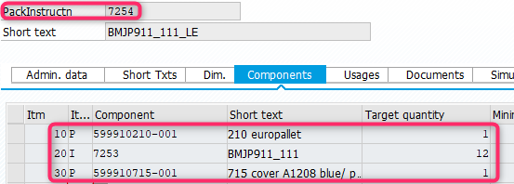
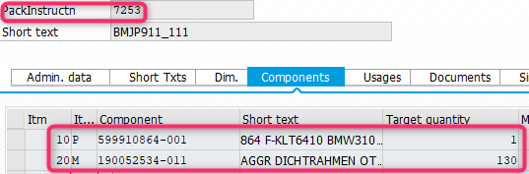
Master Data
Packaging Instruction POP3
e.g. 190052534-011
7254
Calculation
PSA 1077112206
FAUF#10014407
3.120 pcs.
3.120 pcs.
1.560 pcs.
Each Pallet:
1x 599910210-001 EU Pallet
1x 599910715-001 Cover
12x KLT Pack instr. 7253
1.560x 1900525354-011
= 2 pallets
12 KLT per Pallet:
12x 599910864-001 KLT
Calculation Packaging:
2x 599910210-001 EU Pallet
2x 599910715-001 Cover
24x 599910864-001 KLT
TARGET RESULT!

Slide 5
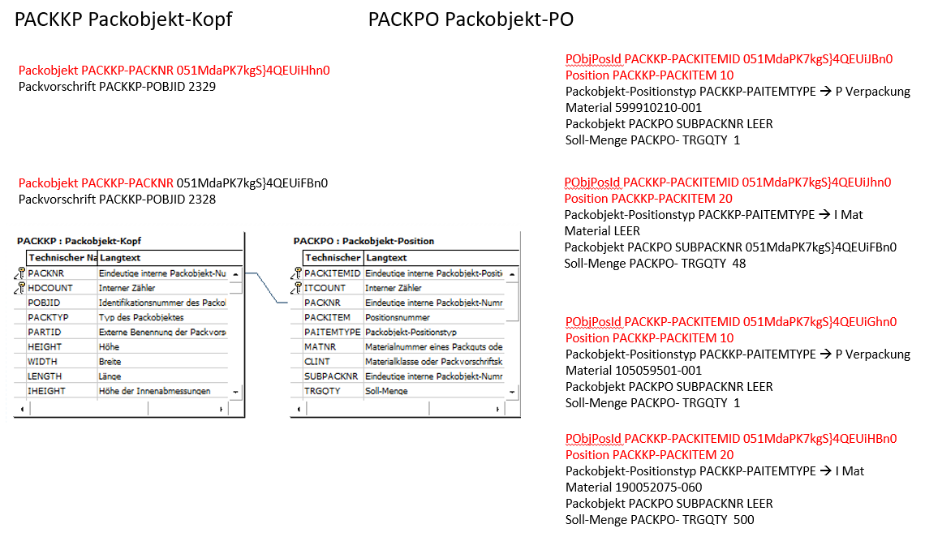
Master Data

Slide 6
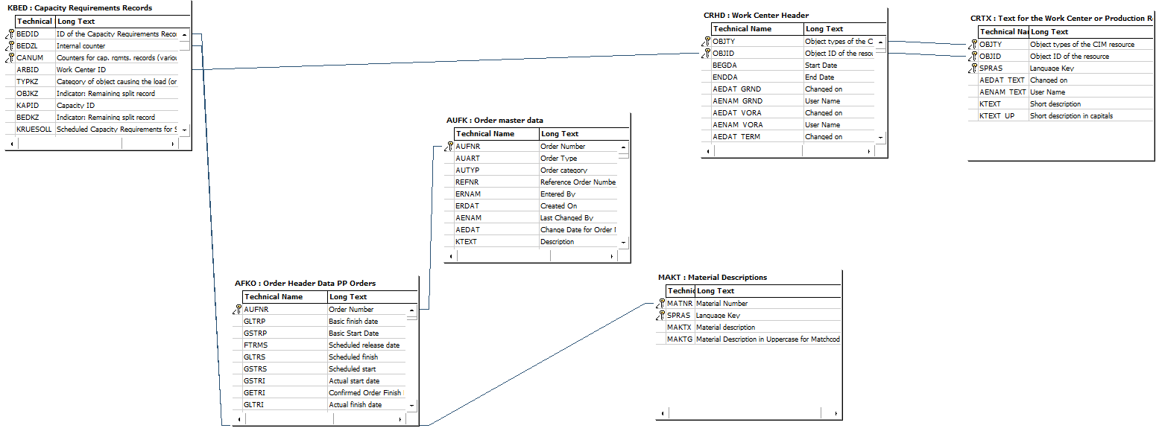
Movement Data
SQVI-Query: Next Production Orders per PSA
SQVI-Query: InfoSet

Slide 7
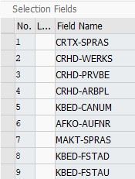
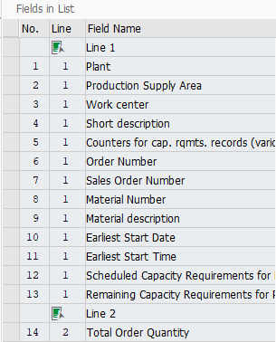
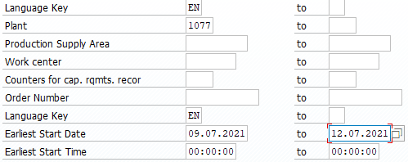
Movement Data
SQVI-Query: Next Production Orders per PSA
SQVI-Query: Selection Fields
SQVI-Query: List Fields
OL144 W. Becker 09.07.2021

