Slide 1




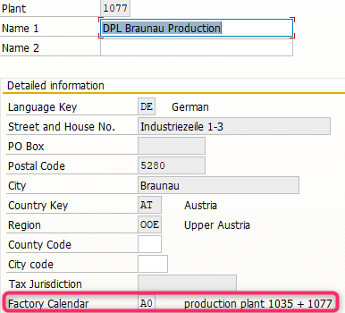


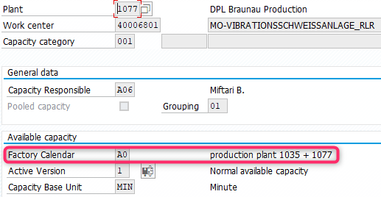

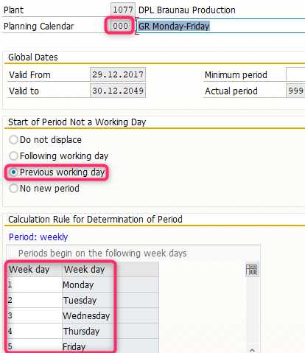
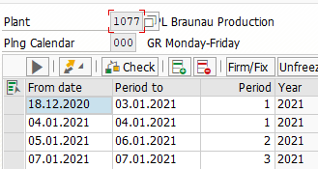
Factory Calendar
MM Goods Receiving
Dock
MM MRP
PP Production
SD Despatch
Shipping Point
PLANT
Certain Delivery days
e.g. only Monday
Master
Work Center
Only for capacity function
(e.g. MF50)
MRP
Shipping Point SD
Customizing OX10
Customizing OVXC
MDG Workflow MRP2
Transaction CR02
Customizing OLVZ bzw. OVXD
Creation MD25/26
See Plant Calendar SCAL
See Plant Calendar SCAL
See Plant Calendar SCAL

