Slide 1


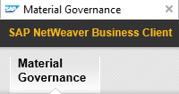
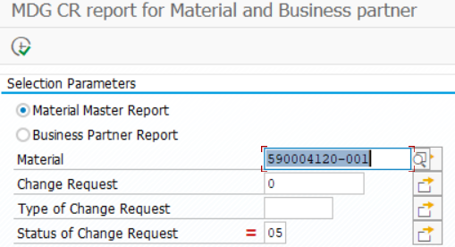
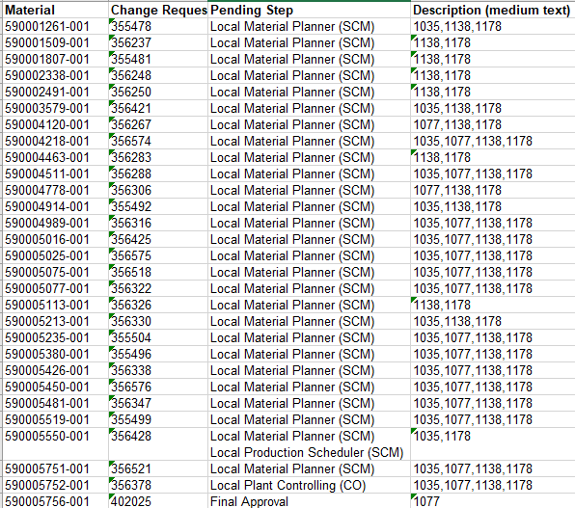

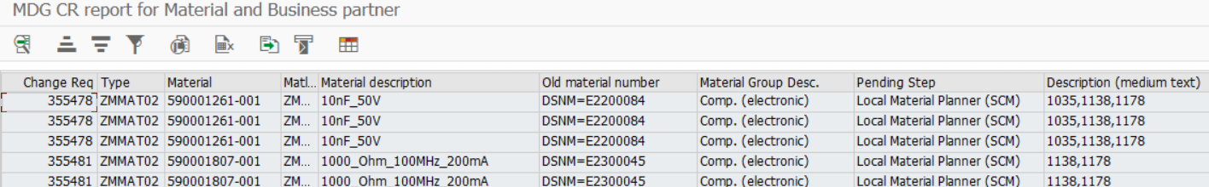
Reporting „Order Readiness Pre-Series“
ENG
Manual
retrievement
MDG – Master Data Readiness
Material Overview Projects
MDG
No possibility to check if one plant has finished if parallel steps in one role (e.g. Local Material Planner (SCM)
Teamcenter
PLM Next
1. Overview open CR Workflow Steps
Selection
Result-Pivot
Out-of-Scope
From
FPL-L
or ALK
Result-Standard
ZMDG_MM_CR_Report

Slide 2

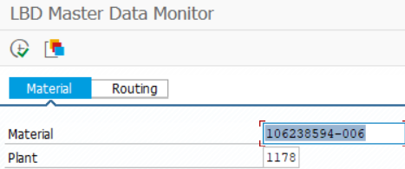
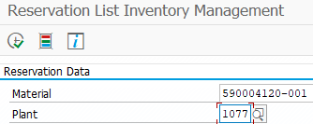

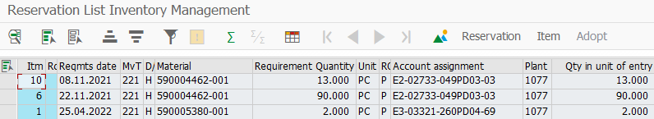

Reporting „Order Readiness Pre-Series“
PS4 – Order Readiness Pre-Series
Automated MRP on components via PIR –ZVSF possible
Manual MRP on components via Material Reservations
PS4
1. Make Parts
2. Buy Parts
Selection: Correct BOM & BOP
Selection: Reservations
Result-Standard
Result-Standard
ZPP_LBD_MON
MB25

Slide 3
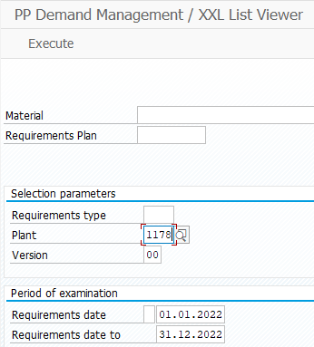
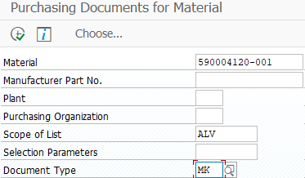
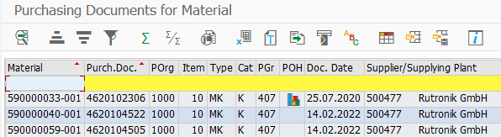
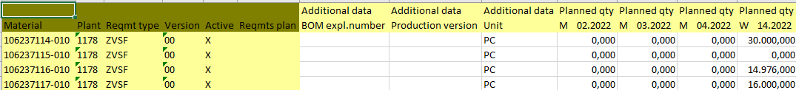
Reporting „Order Readiness Pre-Series“
PS4 – Order Readiness Pre-Series
Automated MRP on components via PIR –ZVSF possible
Manual MRP on components via Material Reservations
PS4
1. Make Parts
2. Buy Parts
Selection: PIR -ZVSF
Selection: Available Purchasing Contracts (462010#####)
Adjust customizing since max. 100 schedule line dates!
Result-Standard
Result-Standard
MD79
ME3M

Slide 4
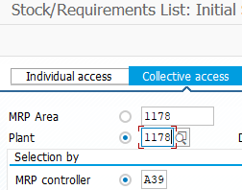
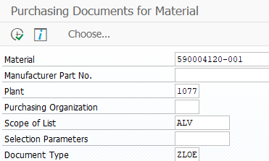
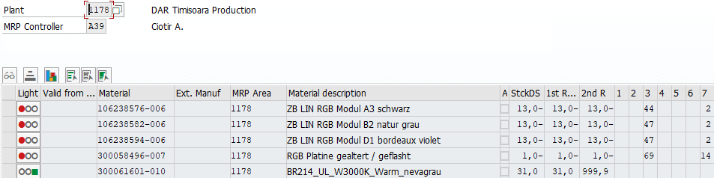
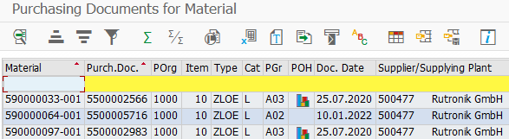
Reporting „Order Readiness Pre-Series“
PS4 – Order Readiness Pre-Series
Automated MRP on components via PIR –ZVSF possible
Manual MRP on components via Material Reservations
PS4
1. Make Parts
2. Buy Parts
Selection: MRP-List (Exception Messages)
Selection: Available MM-Scheduling Agreements (550000####)
Result-Standard
Result-Standard
MD07
ME3M

Slide 5
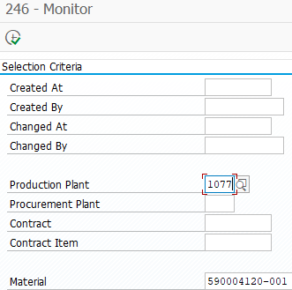

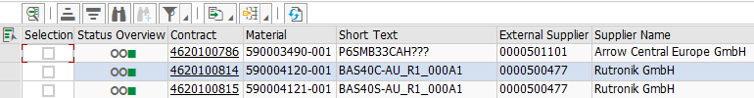
Reporting „Order Readiness Pre-Series“
PS4 – Order Readiness Pre-Series
Automated MRP on components via PIR –ZVSF possible
Manual MRP on components via Material Reservations
PS4
1. Make Parts
2. Buy Parts
Selection: GAP-246 worked correct
Result-Standard
ZMM_246N_MONITOR

Slide 6
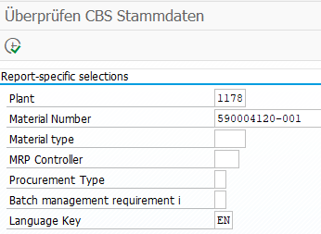
Reporting „Order Readiness Pre-Series“
PS4 – Order Readiness Pre-Series
PS4
General Master Data Review
Selection: Example Selection Screen
Result-Standard
Alternatively ZMM60 enlarged customizing
Align Christine Schinagl SYNRE-1183
ZQ_SCM01_00#
Query to be designed by SYNRE

Slide 7
BACKUP

Slide 8



Operative Praxis-Beispiele
PPE DIUS
AMG S-Box
VIB
Kurzfristige
Verlagerung von
BRA nach TEM
(über 100 Mat.nr.)
CS02 PSP-Shoppingcard
S-Box Mat.nr.
(Mat.nr. in Klärung)
1077 BRA
1178 TEM
Lieferant
1138 Cross-Dock VIB
G6X/RR24 AMB-Light
Sternkoppler
BEA 3.0
PS4 PSP-Shoppingcard
LED ohne Mat.nr.
(590005140-001)
Einmaliges Robben von Braunau oder
Serienbelieferung TEM
(ca. 5 Mat.nr.)
Kurzfristige
Verlagerung von TEM Bestellungen nach Braunau
(ca. 200 Mat.nr.)

Slide 9

Optimierung des Zusammenspiel Projektorganisationen
Guhde (OC)
Gramling (OC)
Blank (OI)
Gurkasch (OE)
Becker
Ertl
Nicole
Günther
1077 BRA
1178 TEM
Lieferant
1138 Cross-Dock VIB
HPL
New Product Launch Manager
ALK
Anlauf-Logistik
Vorserie-Dispo
Serien-Dispo
Gesamtprojekt-verantwortung
Sensibilisierung
ECR-Freigabe z.B. vorsorglich für mehrere Werke
Kick-Off
Infostreuung, insb. lokale Personen
Sicherstellung weiterer Funktionen
Bedarfs-bündelung
Eingreifen im Engpassfall
Bestellungen anlegen
Reporting
Stammdaten-überprüfung (Werk, MDG-Flow, Kontrakte, Menge & Termin)
SAP-Expertise (Work-Around-Prozesse)
Schnelligkeit
Einholen von Terminen
Weitergabe Eskallationsfälle
Sicherstellung Tagesgeschäft

Slide 10
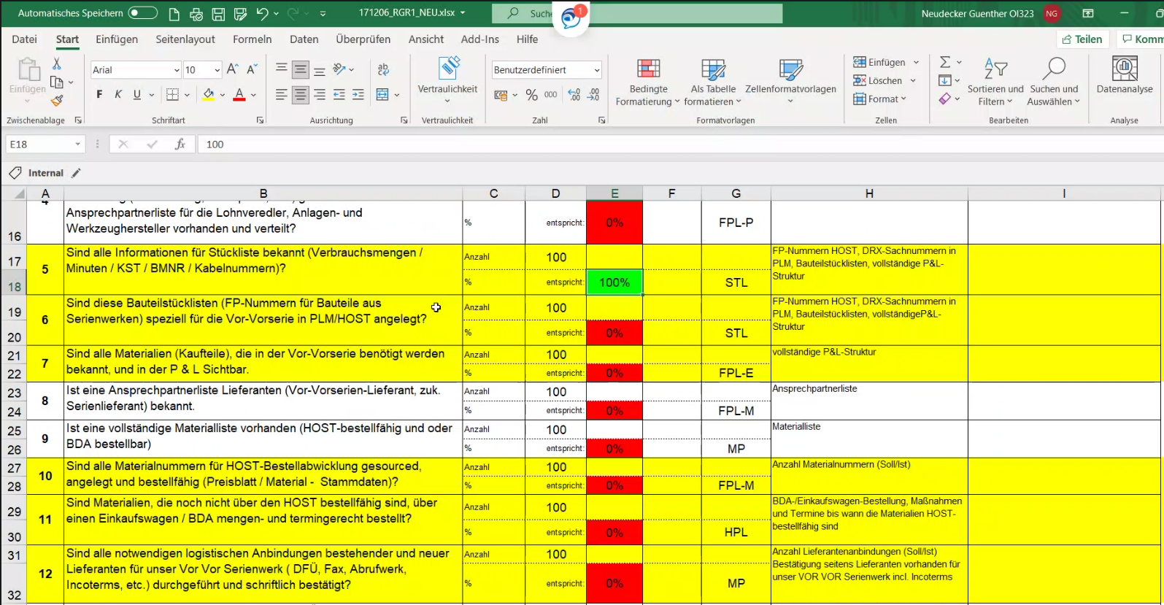
Beispiel: Reifegrad-Tracking OI

Slide 11
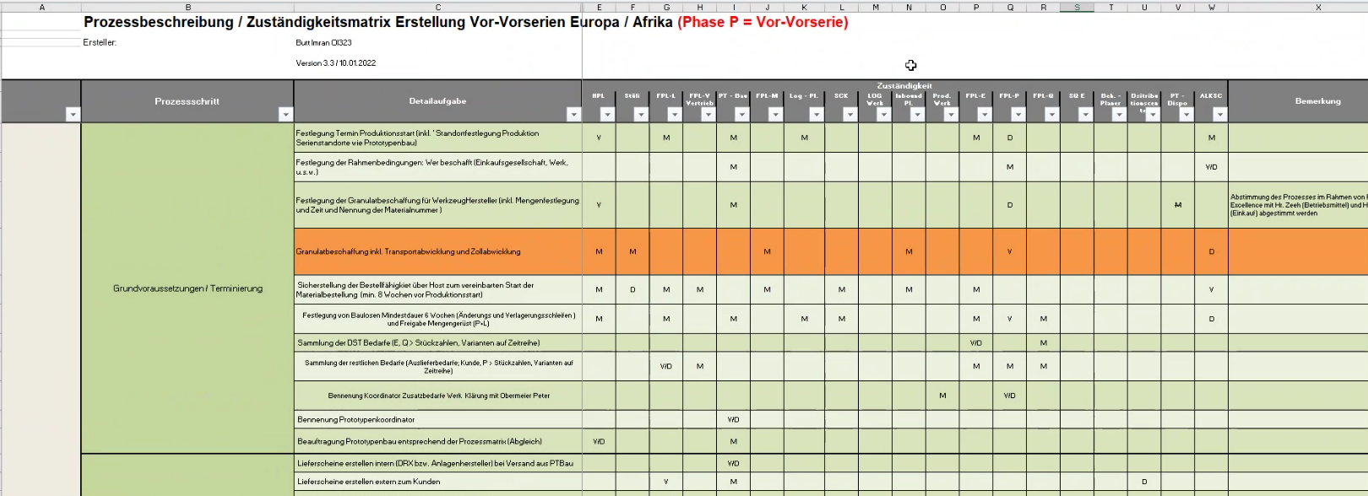
Zuständigkeitsmatrix Anlauf-Projekte (OI)

