Slide 1



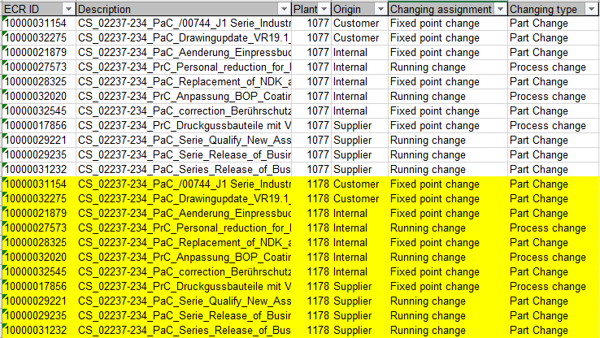
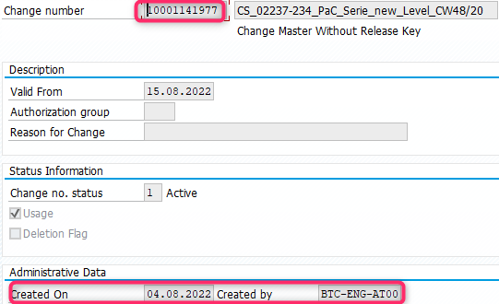
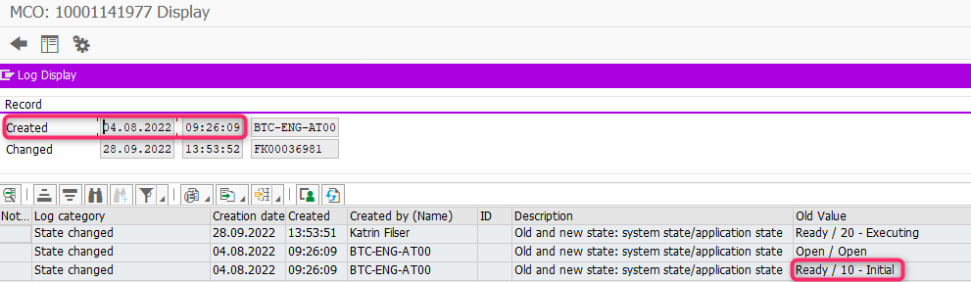
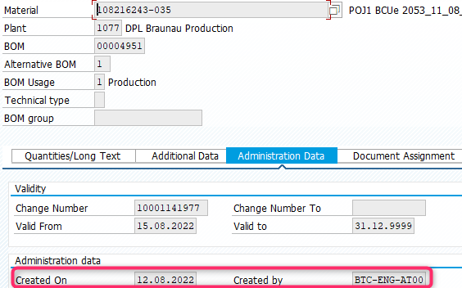
Change Mgt. @DRX
ECR = ENG Change Request
MCO = Manf. Change Order
MCO 10001141977
CC03: 04.08.
Status 10 Initial (04.08.2022)
ZCA_CC_MCO_COCKPIT: 04.08.
Release
Release BOM-Manager
CS03: 1077_108216243-035: 12.08.
ECO = ENG Change Order
Open: Teamcenter Release Strategy
Christian Marsch 10.01.2023
MDG: CR684621 Stat. 35 1077_108216243-035: 12.08.

Slide 2
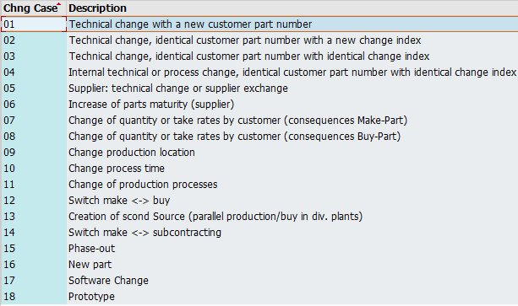
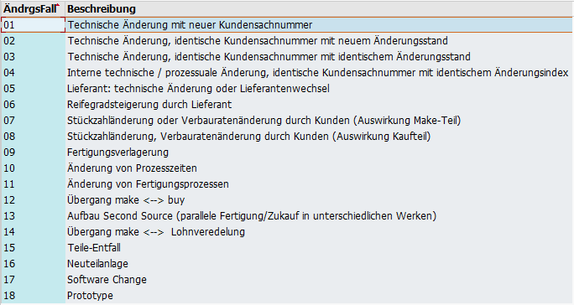

Change Mgt. @DRX (SYNRE-1433)
18 MCO Change Cases:.
New Change Case:
Running technical change on component level w/o index change on upper level incl. Customer part no.
Alternative Parts
Governance Wolfgang Pfeiffer / Grit Schieborowski (Verena Stallhofer)
ELFE parts
Remaining parts – PLM Next
All parts
ECR / ECO
MCO = Manf. Change Order
Andreas Altmann
Jessica Fuchs/ Daniel Pichlmaier
Werner Becker

Slide 3


19 Running Technical Change:
Lower component → material number change
Upper component → no material number change
Phase-Out
Lower Component
Technical change
Upper Component
590005586-001 BAV23C (Diode)
from 577926 Avnet
Software A
Phase-In
300063470-012 UL_W3000K_S5
W214 ELFE
590005586-002 BAV23C (Diode)
from 577926 Avnet
Software B
Open: Current ACS Solution

Slide 4
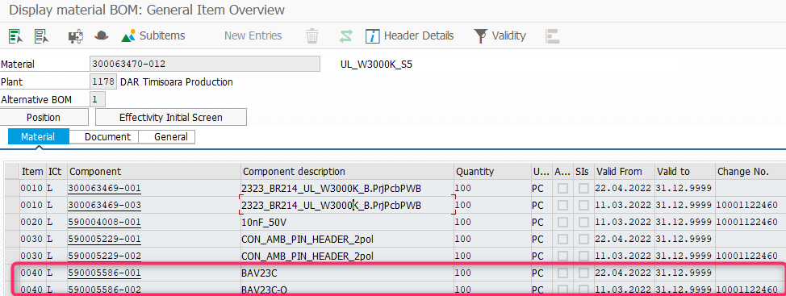
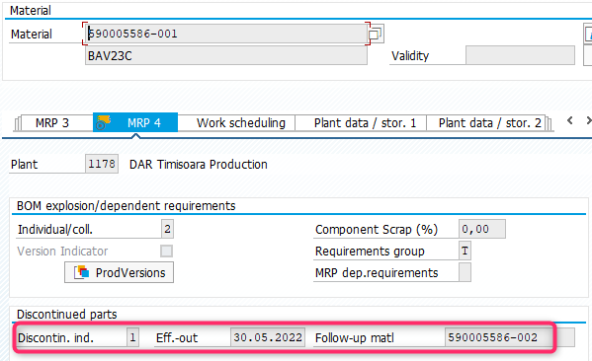
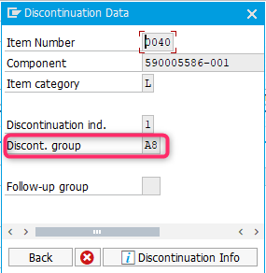
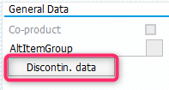
19 Running Technical Change:
Lower component → material number change
Upper component → no material number change
Setting
MM03 Master Data via MDG
Lower Components 590005586-001
CS02 Routing
Upper Component 300063470-012
Set Discontin. Ind. to 1 plus Eff.out. Date when MRP should not create or consider any further materials from run-out part.
Follow-up material 590005586-002 needs to be maintained as well:
Add Run-Out/ -In component in the same Item No. (e.g. 0030)
Double-Click on Phase-Out Item to maintain Discontinuation (e.g. A8 - just a naming to identify the corresponding changes)

Slide 5
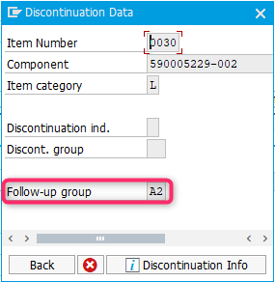
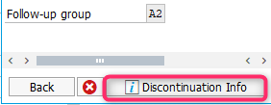
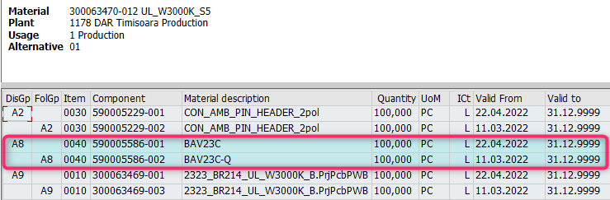
19 Running Technical Change:
Lower component → material number change
Upper component → no material number change
Setting
MM03 Master Data via MDG
Lower Components 590005586-001
CS02 Routing
Upper Component 300063470-012
Set Discontin. Ind. to 1 plus Eff.out. Date when MRP should not create or consider any further materials from run-out part.
Follow-up material 590005586-002 needs to be maintained as well:
Double-Click on the Phase-In Item to maintain Fllow-up group (e.g. A2 - just a naming to identify the corresponding changes)
By clicking button „Discontinuation Info“ the change A8 being displayed for checks:

Slide 6
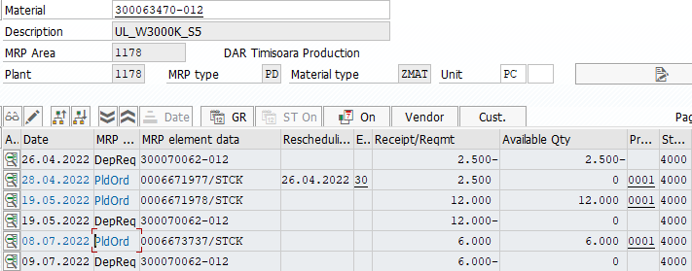
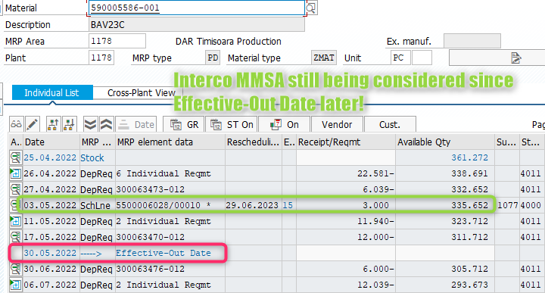
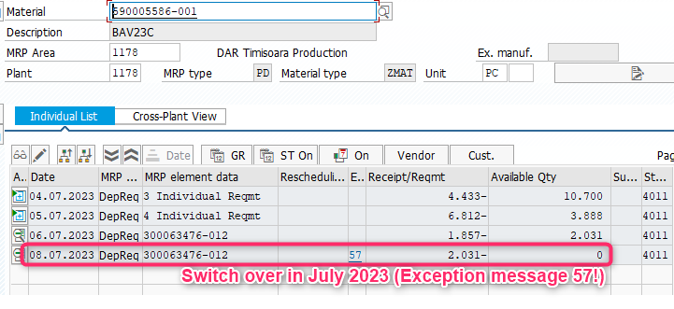
19 Running Technical Change:
Lower component → material number change
Upper component → no material number change
Setting
MRP MD04
Lower Components
CS02 Routing
Upper Component 300063470-012
Phase-Out: 590005586-001

Slide 7
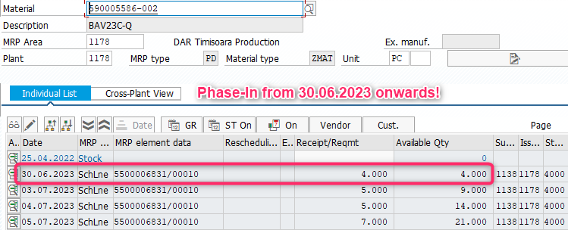
19 Running Technical Change:
Lower component → material number change
Upper component → no material number change
Setting
MRP MD04
Lower Components
CS02 Routing
Upper Component 300063470-012
Phase-In: 590005586-002

Slide 8
20 Alternativ Parts:
To be edited

