Slide 1
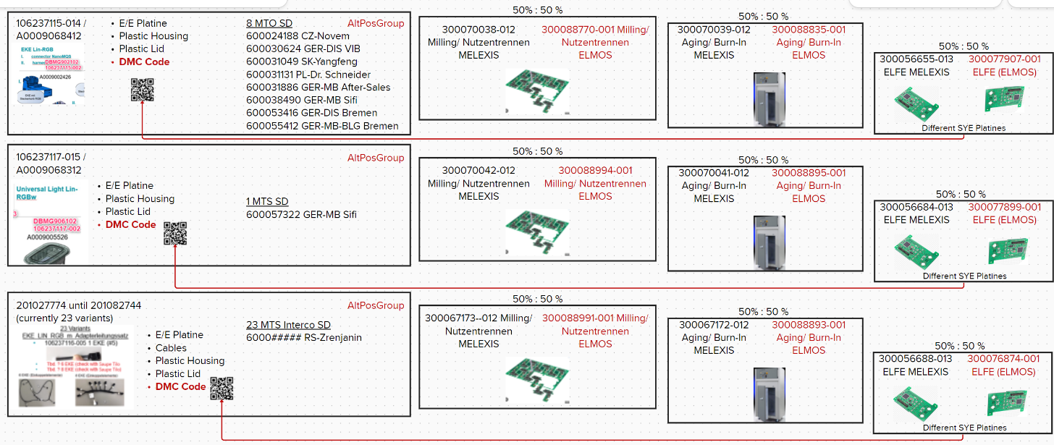
Highlevel production 214 AMB Melexis/ Elmos 26.05.2023

Slide 2

Highlevel timeline 214 AMB Melexis/ Elmos 26.05.2023
May
June
July
August
September
Info about complex
supply chain (no call-off Elmos/SYE)
Manual settings
„dummy mat.no.“ SOP 9.5.
Manual settings
„real mat.no.“ SOP 9.5.
Manual BOM Alternative 2 incl. AltItemGroup
Manual settings
„real mat.no.“ SOP 1.7.
590005910-001 Melexis + SYE Variants
50%
590005910-001 Melexis + SYE Variants
BOM Alternative 2 incl. AltItemGroup
(automated FAUF to be tested)
TC BOM Alternative 1
590006036-001 Elmos + SYE Variants
50%
BOM Alternative 3 w/o AltItemGroup
(manual FAUF)

Slide 3
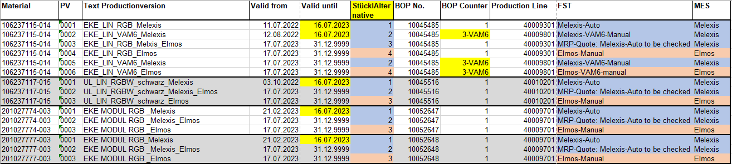
78 Production Versions necessary
VAM5
(main)
VAM6
(Alternative)
100% Melexis until July
50% Melexis/ 50% Elmos from July
Elmos manually from July
Alternative BOM‘s/ AltItemGroup/ Manual adjusted BOM/ PIR = ZVSF (MD61 & MD74)

Slide 4
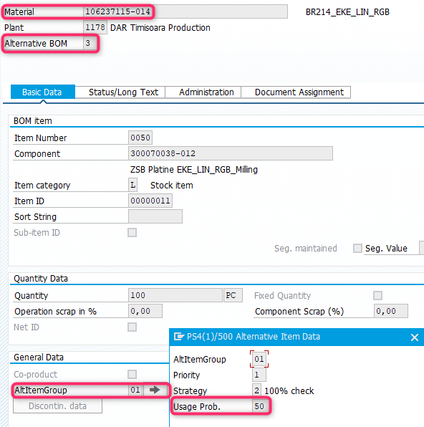
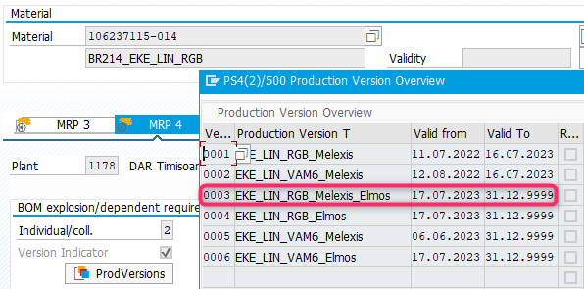
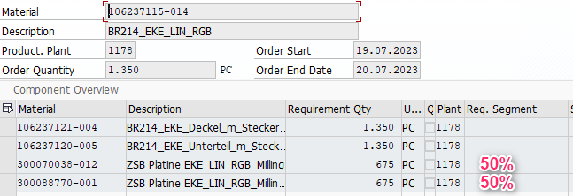
AltItemGroup on final assembly for 50%50 quote
AltItemGroup
Production Version
50% : 50% Split

Slide 5
Back-Up
History

Slide 6
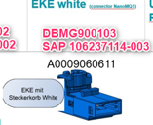
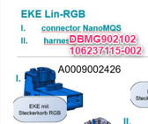

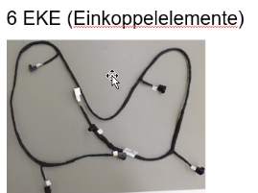
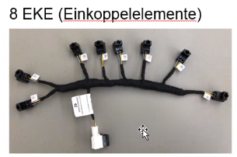
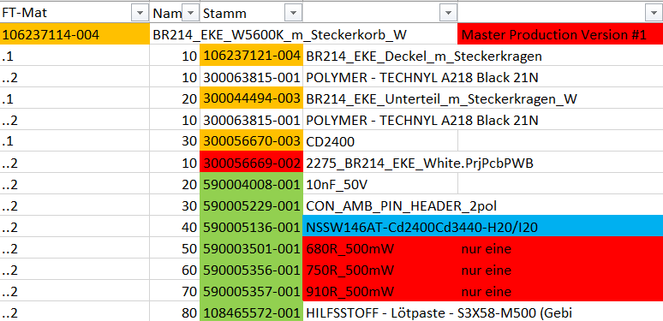
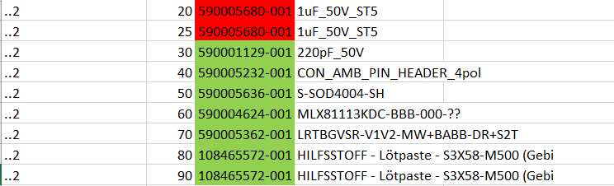
Highlevel Structure W214 AMB Project – Connectors 1178 TEM
3 Variants EKE White-Steckerkorb
106237114-004 (Master Production Version #1)
(Production Version #2)
(Production Version #3)
1 Variant EKE_LIN_RGB
106237115-004 (#4)
23 Variants EKE_LIN_RGB_m_Adapterleitungssatz
106237116-005 1 EKE (#5)
      Tbd. ? 6 EKE (check with Saupe Tilo
      Tbd. ? 8 EKE (check with Saupe Tilo)
From cw. 45 all
Housings from BRA!
Manual Indication on the LED-Comp. from supplier Nichia:
Mat.no. 590005136-001
Elfe parts:
TEM Finished product needs to be delivered for further completion (cable) to Serbia (Zrenjanin ZRE) and then returned to TEM
again for final customer
(similar like Cahul)
See separate ppt
Rutronik
BOM
MRP-relevant
Order 3
Built only 1
Diffence ELFE resitor BOP & BOM
Manual assignment
ELFE part to FAUF?!
Difference ELFE empty platine BOP & BOM
106237115-004 (#4)
300056655-003 EKE_LIN_RGB
300056653-002 Empty Platine 2274_BR214_EKE_LIN_RGB.PrjPcbPWB
Supplier SYE
106237116-005 (#5)
300056688-003 EKE_LIN_RGB_H
300056687-002 Empty Platine 2303_BR214_EKE_LIN_RGB_H.PrjPcbPWB
Supplier SYE
106237114-004 (Master #1)
300056670-003 CD2400
590003501-001 680R_500mW
Supplier Rutronik
Production Version (#2)
300056671-002 CD2880
590005356-001 750R_500mW
Supplier Rutronik
Production Version (#3)
300056672-002 CD3440
590005357-001 910R_500mW
Supplier Rutronik

Slide 7
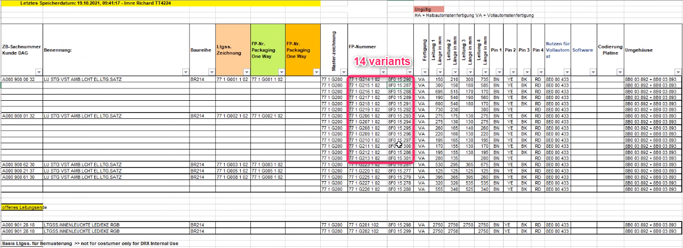
Highlevel Structure W214 AMB Project – RGB Adapter 1178 TEM
14 Variants for EKE_LIN_RGB_m_Adapterleitungssatz to Zrenjanin ZRE Serbia via HOST and return
(contact Mr. Tilo Saupe) – similar Cahul Process?
SD Finished Product?
A0009000032
A0009000132
MM Supply
HOST production E6 ZRE ES
HOST Sales Plant 01 TEM ES
HOST ordering D6 cross-dock ES?
14 components
HOST production 83 TEM ES
HOST ordering C4 TEM ES

Slide 8
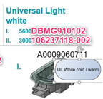
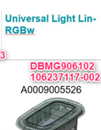
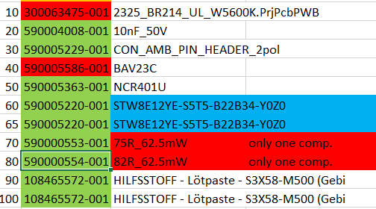
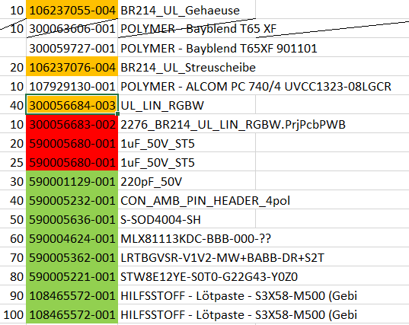
Highlevel Structure W214 AMB Project – Lights 1178 TEM
1 Variant UL_LIN_RGBW_schwarz
106237117-004 (#6)
2 Variants UL_W5600K_Kalt_schwarz
106237118-004 (Productionversion #7)
(Production version #8)
Manual Indication on the LED-Comp. from supplier Avnet:
Mat.no. 590005220-001
Rutronik
Pls. add 2nd Resitor 554 in Master Production Version #7!!
Difference ELFE resitor BOP & BOM
Manual assignment
ELFE part to FAUF?!
106237118-004 (Master #7)
300063476-002 UL_W5600K_S5
590000553-001 Resitor 75R_62.5mW
Supplier Rutronik
One-Time Electronic Direct
(Production version#8)
300063477-002 UL_W5600K_T0 590000554-001 Resitor 82R_62.5mW
Supplier Rutronik
One-Time Electronic Direct

Slide 9

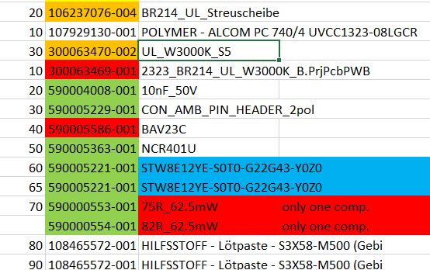
Highlevel Structure W214 AMB Project – Lights 1178 TEM
2 Variants UL_W3000K_Warm_schwarz
106237119-004 Warm_schwarz (#9)
300044495-003 BR214_UL_Gehaeuse_W_schwarz
Manual Indication on the LED-Comp. from supplier Avnet:
Mat.no. 590005221-001
Rutronik
Difference ELFE resitor BOP & BOM
Manual assignment
ELFE part to FAUF?!
106237119-004 (Master #9)
300063470-002 UL_W3000K_S5
590000553-001 75R_62.5mW
Supplier Rutronik
One-Time Electronic Direct
(Production Version #10)
300063471-002 UL_W3000K_S5
590000554-001 82R_62.5mW
Supplier Rutronik
One-Time Electronic Direct

Slide 10
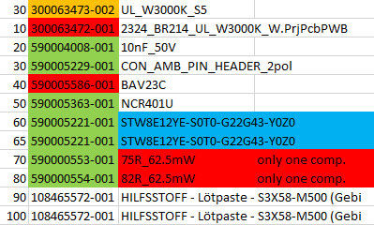
Highlevel Structure W214 AMB Project – Lights 1178 TEM
2 Variants UL_W3000K_Warm_macchiatobeige
300061599-002 machiabeige(#11)
300061600-002 BR214_UL_Gehaeuse_W_macchiatobeige
Manual Indication on the LED-Comp. from supplier Avnet:
Mat.no. 590005221-001
Rutronik
Difference ELFE resitor BOP & BOM
Manual assignment
ELFE part to FAUF?!
300061599-002 (Master #11)
300063473-002 UL_W3000K_S5
590000553-001 75R_62.5mW
Supplier Rutronik
One-Time Electronic Direct
106237119-004 (Production Version #12)
300063474-002 UL_W3000K_S5
590000554 001 82R_62.5mW
Supplier Rutronik
One-Time Electronic Direct

Slide 11
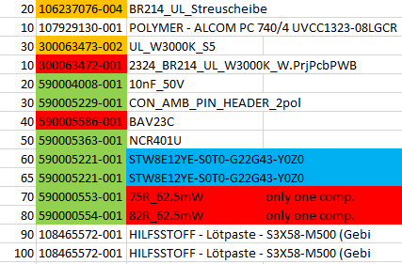
Highlevel Structure W214 AMB Project – Lights 1178 TEM
2 Variants UL_W3000K_Warm_nevagrau
300061601-002 nevagrau (#13)
300061602-002 BR214_UL_Gehaeuse_W_nevagrau
Manual Indication on the LED-Comp. from supplier Avnet:
Mat.no. 590005221-001
Rutronik
Difference ELFE resitor BOP & BOM
Manual assignment
ELFE part to FAUF?!
300061601-002 (Master #13)
300063473-002 UL_W3000K_S5
590000553-001 75R_62.5mW
Supplier Rutronik
One-Time Electronic Direct
(Production Version #14)
??? UL_W3000K_S5
590000554 001 82R_62.5mW
Supplier Rutronik
One-Time Electronic Direct

Slide 12
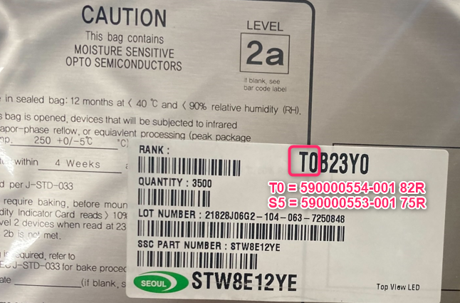
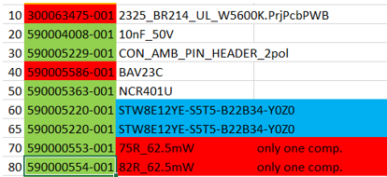
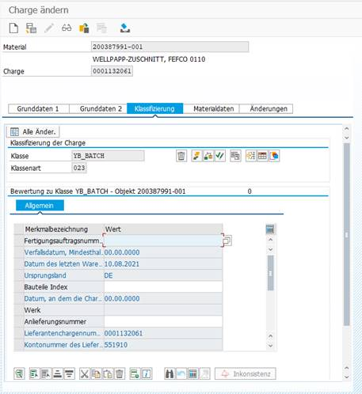
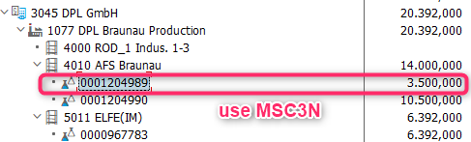
Example: BR214 106237118-004 UL_W5600K_Kalt_schwarz
LED 590005220-001
LED 590005221-001
Supplier AVNET
T0 = 590000554-001 82R
Batch 99999
S5 = 590000553-001 75R
Batch 88888
Stock Overview: MMSC
Draft
Batch: MSC2N / MSC03N
e.g. Classification

Slide 13
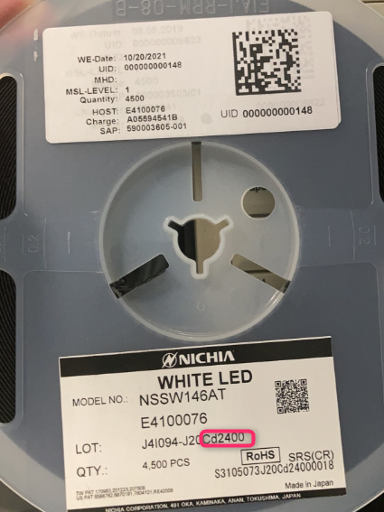

Example: BR214 106237114-00# EKE White-Steckerkorb
LED 590005136-001
Supplier Nichia
Cd2400 = 590003501-001 680R
Cd2880 = 590005356-001 750R
Cd3440 = 590005357-001 910R
Stock Overview: MMSC
Draft
Batch: MSC2N / MSC03N
e.g. Classification

Slide 14
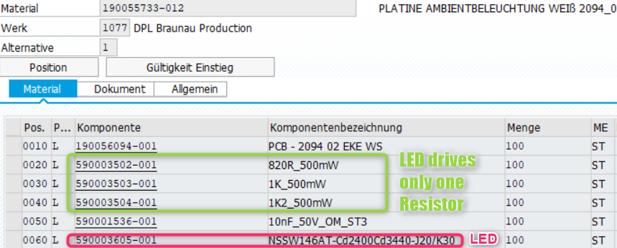
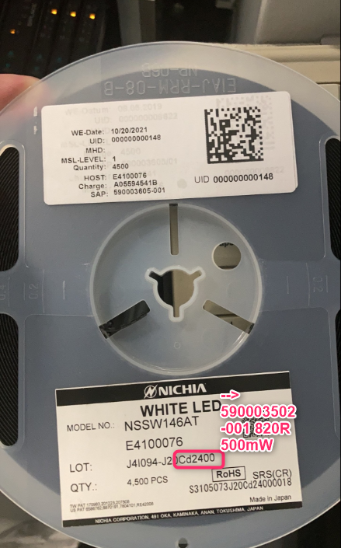
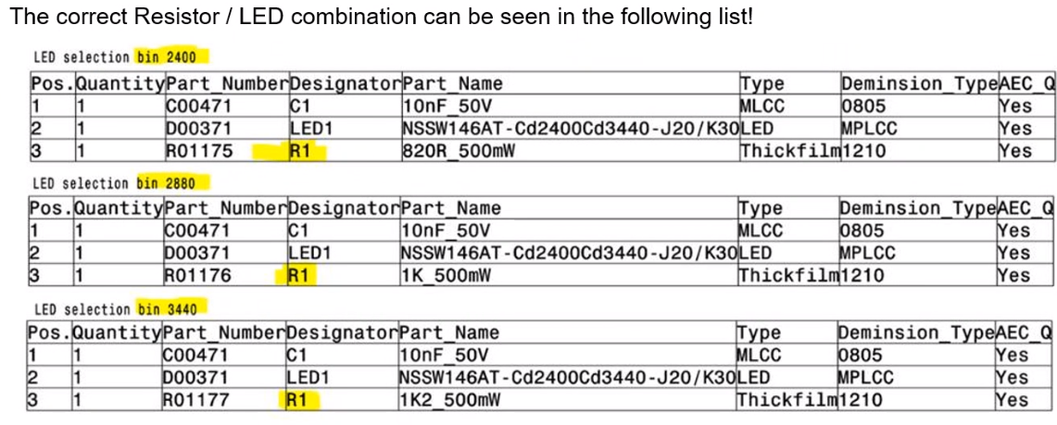
Example: MFA2 White 190055733-012/-024

Slide 15
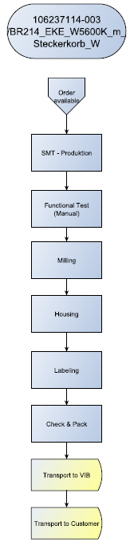
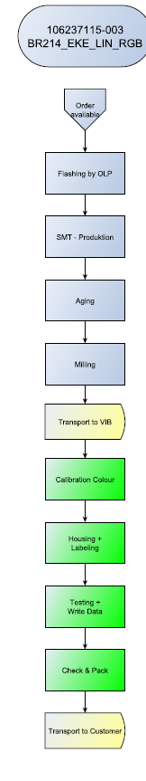
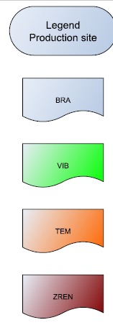
SAP 1077
DPL
Anlagen
Lohnbereitstellung
Nicole
DBMG900102
DBMG900103
HOST Plant 12
ELDRA VIB
Supplier 50L408
SAP 1077
DPL
1614000
HOST Plant 12
ELDRA VIB
Supplier 50L408
DBMG902103

Slide 16
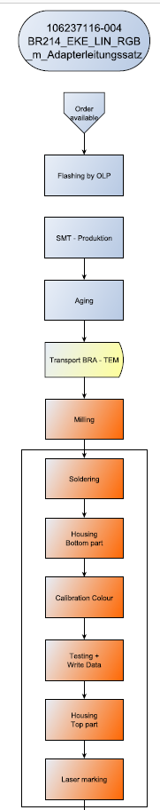
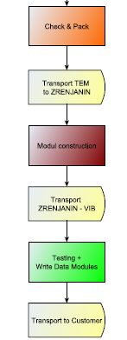
SAP 1077
ELFE Part
HOST C4
AMB part
HOST D6
E/E part
Nicole
Manual
Prototype
HOST Plant 12
ELDRA VIB
Supplier 50L408

