Slide 1
Standard–Demo PULL Prinzip in der Produktionsversorgung
OG GTT as of 23.05.2023

Slide 2
Agenda
1. KANBAN - Introduction
2. KANBAN Master Data
2.1 Supply Area
2.2 Control Cycle
3. KANBAN Procedures
3.1 Classic Kanban
3.2 Event-Driven Kanban
3.3 One-Card Kanban
3.4 Kanban w. Quantity Signal
4. Replenishment Strategy
4.1 Replenishment w/o MRP
4.2 Replenishment w MRP (In-House Production)
5. System Demonstration

Slide 3
1. KANBAN – Introduction PUSH and PULL Principles
Material is pushed through production based on times calculated – PUSH Principle
Major Characteristics of PUSH
MRP is used to create current and future demands for dependent materials and processes
Emphasis is laid on high-level capacity utilization
Uses customer orders/forecast demand for finished goods, BoMs, current inventory information/production orders/schedules to generate demands for subassemblies and externally procured items.
Materials are called from the supply source by production at the manufacturing level whey they are needed – PULL principle (Demand-based and Event-driven)
Major Characteristics of Kanban
Consumption of Kanban parts must be relatively constant within an interval which is longer than the replenishment lead time of the Kanban
Supply source must be able to produce large quantities of requested material in smaller lots in a short time. (Process optimization via reduced setup times/sequencing, etc.)
Recommended producing items with less variations in configuration

Slide 4
1. KANBAN – Introduction KANBAN Philosophy – Extract I
Principle PULL Production – Consumption controls replenishment on direct requests from demand source, actual not prediction of the future demand usage.
Procedure Material flow via containers, when the demand source empties a container the replenishment signal is triggered (in-house production, ext. vendor, storage location) at the time of actual demand (demand-based replenishment.
Technique Self-controlling control cycles, supply areas
Benefit Stocks and lead times reduction
Backflushing / Controlling By setting the KANBAN to FULL (Goods Receipt)
Object KANBAN (container and card) in connection with replenishment element
Source: SAP

Slide 5
1. KANBAN – Introduction KANBAN Philosophy – Extract II
Material flow is organized using containers kept directly at the PSA in the production.
Emptied container at the demand source initiates replenishment
Sources of supply:
In-house production
External procurement
Warehouse
Aim: The production process is controlled by production itself
Summary: Material is staged where it is used; Consumed material is replenished using Kanban.
KANBAN Card - Content
What is produced
How much is produced
Where it is produced
Where it is delivered
How it is transported
………

Slide 6
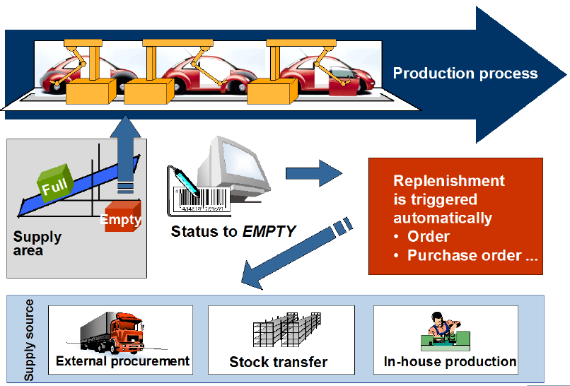
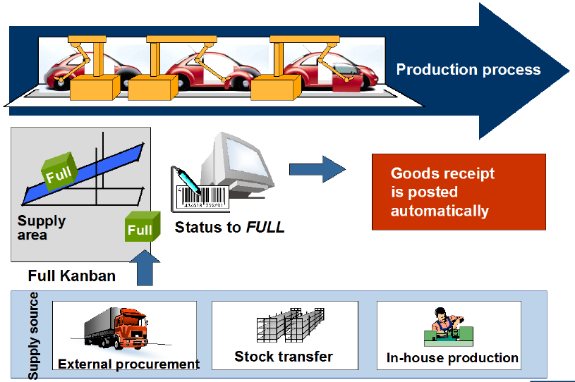
1. KANBAN – Introduction Kanban Statuses - EMPTY / FULL
KANBAN Progress – status controlled; minimally only 2 statuses can be used, viz: “EMPTY” and “FULL”
Setting the status: “EMPTY” triggers the system to generate a replenishment element, instructing the source supply to deliver.
Emptying the Kanban does not reduce inventory
….
KANBAN Progress – status controlled; minimally only 2 statuses can be used, viz: “EMPTY” and “FULL”
Setting the status: “FULL” triggers the system to post a Goods Receipt with reference to the procurement element.
…..
Source: SAP

Slide 7
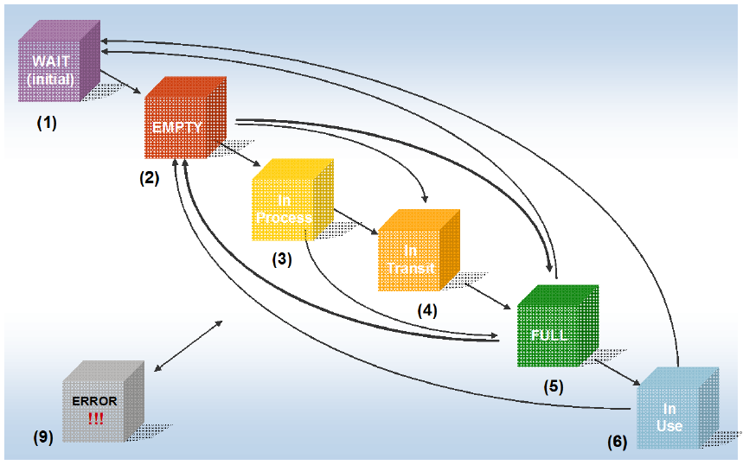
1. KANBAN – Introduction KANBAN Statuses
The following additional statuses (in addition to “EMPTY” and “FULL” are helpful especially when using the KANBAN board, as they provide valuable information on production or procurement processes.
WAIT – status assigned to a newly included Kanban in the control cycle but it’s inactive. Change of status to EMPTY activates the Kanban
PRCESS – indicates the production of the requested material by the supply source
TRNSIT – indicates that the requested material is on its way to the demand source
IN USE – indicates that the demand source is currently redrawing material
ERROR – is set up by the system to indicate an unsuccessful change of status
FULL
In Transit
Demand
In Process
Source
EMPTY
Supply
Source
Source: SAP

Slide 8
1. KANBAN – Introduction Major Prerequisites for Implementing Kanban
Harmonization and Standardization of the production program. Steady parts consumption minimizes fluctuation on the shop floor, and this leads to a more stable production process. Consumption of parts must be relatively constant within a period that is longer than the replenishment lead time of a Kanban container.
Material flow-oriented workshop organization The nature of the layout must be a process-oriented resource design, i.e., it must be process-flow orientated.
Quality Assurance Since neither buffer no reserve parts are planned in this process the passing on of defective parts must stopped at all costs.
Smoothed production The supply source must be capable of producing a large of small lots within a short period (Optimization methods for sequencing such as reduction in setup times must be practiced)
Shortening/Standardization of (transport) cycle times The reduction of inventories calls for increased transport effort. Effective material transport from upstream to downstream locations must be ensured.

Slide 9
2. KANBAN Master Data Production Supply Area
Production Supply Area (PSA)
Supply Area: defines a physical area but is not an inventory object ➔ storage locations are assigned to the PSA for inventory management
Responsible: the person responsible is identified by the supply area; The person is responsible to monitor stocks at the supply area
Unloading Point: Used normally in external procurement processes since the supplier does not deliver directly the PSA. Irrelevant in our case
Consumer-specific Factory Calendar, Shift Grouping and Shift Sequence ➔ Information derived from Customizing settings for maintaining work center capacity information
Pull Interval (Days) / (hh:mm) ➔ Time interval for transfer of requirements from the customer (demand source) to the supply source.

Slide 10
2. KANBAN Master Data Control Cycle
KANBAN Control Cycle
The Control Cycle defines the relationship between the demand and supply sources. The following information content is required:
Production Supply Area
Supply Source (the person responsible for the in-house production, supply area)
Number of containers circulating between and supply
Quantity for each container
Delivery address
Print parameter for printing card
Pallet position (e.g., a specific area in the area)
Life Cycle Status
2
3
4
5
1

Slide 11
3. KANBAN Procedures
Classic Kanban
In this method, the objects “control cycle”, “demand source” and “supply source” are required to determine the production/replenishment procedure. The Kanban signal always only triggers the replenishment quantity defined in the control cycle. More Kanbans than defined in the cycle cannot be circulated
Event-Driven Kanban
Material staging is based only on actual consumption, i.e., not on the number Kanban containers or pre-defined Kanban container quantity. Replenishment takes place only when specifically requested for. Separate/Specific-dedicated control cycles are required.
Kanban signal always only triggers the replenishment quantity defined in the control cycle.
Examples of triggered events are stock-level calculations, one-time demand, customer demand
One-Card Kanban
Used for 2 (active) Kanban containers in a control cycle; Replenishment is triggered when the quantity in the container at the demand source falls below half (or specified quantity) of the Kanban container quantity that’s being currently emptied. New Kanban is delivered before the current Kanban is completely empty. Statuses: “In Use” / “Waiting”
Kanban with Quantity Signal
Use of PDC system to communicate the withdrawn quantity from the Kanban container that sets the status to “Empty”.

Slide 12
4. KANBAN Replenishment Strategy
Replenishment w/o MRP
The material in question is not planned, i.e., MRP Type is set to “ND”
No replenishment elements (planned order / purchase requisitions) are generated by the MRP run
The material must be excluded from the storage location assigned to the Production Supply Area
……..
Replenishment w MRP (In-House Production)
The material in question is planned, i.e., MRP Type is set to “PD”
Replenishment elements (planned order / purchase requisitions) are generated by the MRP run
Dependent requirements can also alternatively be managed by Kanban procedures
The material must be included from the storage location assigned to the Production Supply Area
…….

Slide 13
3. KANBAN Replenishment Strategy Overview - Production BoM Structure
PUSH (MRP)
Customer-Demand-Driven (Sales Order –Sched. Agreements)
PULL – (Supply-to-Production)
Preconfection
Triggered manually
Container Ref.: KANBAN
190053963-020 ZSB HSB POLO
Module Assembly
Planned Oder → Prod. Ord → Shop Floor System
1900559890-021
HSB POLO UT 6
Preassembly (VK)
200195898-001
SIS FUER HSB AU210
105562306-001
THREAD BOLT-M6x12
190033182-001
VERSTAERKUNGSTEIL
3000 88XXX-NNN
Dependent re-quirement
Planned Order
“PULL”
“PULL”
“PULL”
105562306-001
THREAD BOLT-M6x12,5
300028381-014 ABDECKUNG BATT.
300028978-002
ADAPTERTRAEGER
3XXXXXXX-00X
(Trimmed Tube)
Procured Item
Cable Cutting
105200100-001 POLYMER - Daplen
107475534-001
POLYMER - DOMAMID
10XXXXXXX-001

Slide 14
3. KANBAN Replenishment Strategy Replenishment with MRP – In-House Production
MRP
MRP for the module assembly generates procurement proposals for all BoM items in the structure
Generated planned orders at preassembly level to produce the module assembly will be converted into production orders, released and produced
Generated planned orders for “Preconfection”- and “Cable-Cutting”- assemblies (items at assembly-group-levels) should not be converted in production orders, i.e., must not trigger production.
This approach aims at providing the supply sources (preconfection/cable- cutting) with demand information in advance.
The supply source does not produce the replenishment element (cable-cutting assemblies) created in MRP immediately but awaits the “Kanban” request from the demand source (preconfection assembly). In a nutshell, a preconfection production order “pulls” (triggers) the cable-cutting production orders
Module Assembly
Precon
Casing
Sellotape
Clips
Cable Cutt_1
Cable Cutt_2
Cable Cutt_3
Wire_1
Wire_2
Tube_1
BoM Structure

Slide 15
3. KANBAN Replenishment Strategy In-House Production – Replenishment using Production Orders I
Mod. Assembly
Prod. Ord Mod. Ass
Mod. Assembly
Prod. Ord Mod. Ass
Preconf_1
3000
(Casing)
Z001
(Sellotape)
Z002
(Clips)
Preconf_1
Preconf_1
3000
(Casing)
Z001
(Sellotape)
Z002
(Clips)
Preconf_1
Casing
Z001
(Sellotape)
Clips
Sellotape
Cable Cutting 1
Cable Cutting 2
Cable Cutting 3
Prod. Ord
CC_1
Prod. Ord
CC_2
Prod. Ord
CC_3
Cable Cutting 1
Cable Cutting 2
Prod. Ord
CC_1
Prod. Ord
CC_2
Prod. Ord
CC_3
Wire_1
Wire_2
Tube_1
BoM Structure
Production Order Structure

Slide 16
3. KANBAN Replenishment Strategy In-House Production – Replenishment using Production Orders II
Mod. Assembly
Prod. Ord Mod. Ass
Mod. Assembly
Prod. Ord Mod. Ass
Preconf_1
Preconf_1
Preconf_1
Preconf_1
Collective Order
Cable Cutting 1
Cable Cutting 2
Cable Cutting 3
Prod. Ord
CC_1
Prod. Ord
CC_2
Prod. Ord
CC_3
Cable Cutting 1
Cable Cutting 2
Prod. Ord
CC_1
Prod. Ord
CC_2
Prod. Ord
CC_3
BoM Structure
Production Order Structure

Slide 17
3. KANBAN Replenishment Strategy In-House Production – Replenishment using Production Orders III
Planned Orders
1900559890-021 - Preassembly- (Dependent requirement)
Forecast, not
delivery
-
relevant
MRP
Module
Date, Quantity
Assembly
Module
Date, Quantity
Planned orders from MRP are reduced when production orders or Kanban run schedule quantities are created by setting a Kanban to EMPTY.
Assembly
Date,
Quantity
Precon
Casing
Sellotape
Clips
<
Control Cycle
Cable
Cable
Cable
>
Cutt_1
Cutt_2
Cutt_3
Set Status → “EMPTY”
Wire_1
Wire_2
Tube_1
Production
Production Order
•
Kanban
1900559890-021 (Preconfection)
-
Delivery-relevant
….
-
•
.
The planned orders from MRP are reduced when production orders (delivery-relevant replenishment elements) are created by setting a Kanban to EMPTY
Date, time,
supply area,
quantity

Slide 18
5 KANBAN Processing
System-Demo

Slide 19
BACK-UP

Slide 20
Event-Driven Kanban

Slide 21
One-Card Kanban

Slide 22
Calculating Number or Required Kanbans

Slide 23
Relevant Kanban Transactions
List of Transactions - Extract
PKMC Control Cycle Maintenance
PK05 PP Maintain Supply Area
PK11 Plant Overview Kanban
PK12 Kanban Board: Supply Source View
PK13 Kanban Board: Demand Source View
PK21 Change Kanban Container Status
PK23 Manual Kanban Creation
PK09 Unlock Kanban
OM15 Maintain Kanban Status Sequences

Slide 24
KANBAN Process w MRP (in-House Production)
Step-by-Step Approach
Create production supply area PK05
Create Control Cycle (Classic Kanban) In-House Prod. PKMC
Create Control Cycle for external procurement Kanban process PKMC
Check MRP Data for Kanban Material(s) MM01/MM02
Customizing Settings SPRO
Maintain status sequences SPRO
Define In-House Replenishment Strategy SPRO
Define External Procurement Strategy SPRO
Select the first control cycle (from the Kanban Board) and Kanban PK13N container, select “to Empty” (System changes colour to green)
Double click on Kanban container to ascertain the details PK13N
Either release production to trigger goods issue (w/o MES/EWM integration) CO02 or
Confirm production order CO11N
Check misc. Material “Movement” Information MD04, MMBE, MB51, ….
Demand Source
Materials
Set Kanban to FULL
Consume materials in production
Supply Source
Set Kanban to EMPTY
Kanban

Slide 25
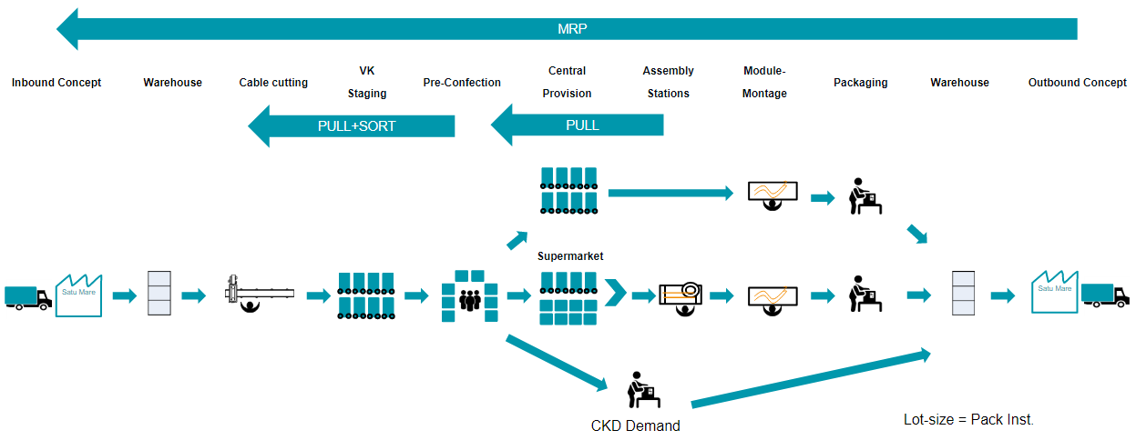
Material Flow – Schematic Overview

Slide 26
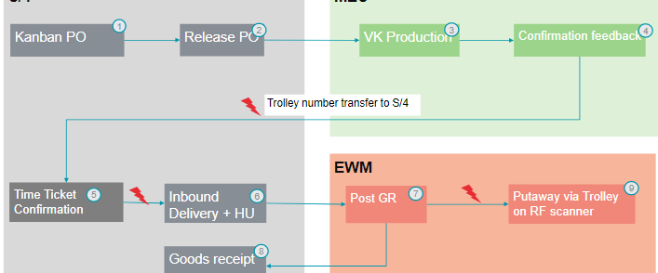
Shop Floor Integration for VK/PC Production Orders – Trolley Reuse
Development - Paperless Trolley Tracking Number

Slide 27
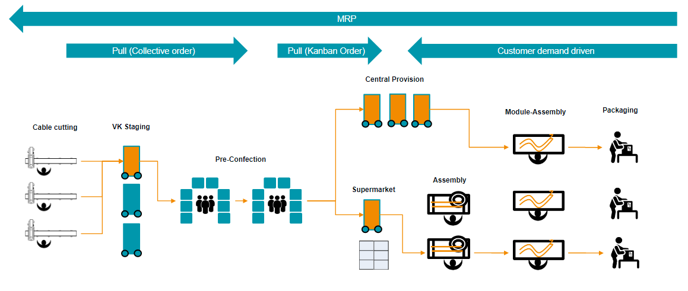
Material Planning and Production Scheduling
Source: Deloitte

Slide 28
3.2 Material Flow – Schematic Overview
Source: Deloitte

Slide 29
Organisation: Kanban is a part of Toyota Prod. Sys. (TPS)
Principle: Going to Gemba, check for Gembutsu, look for Muda, make Kaizen
GEMBA Physical location of point of interest (GER Ort des Geschehens)
GEMBUTSU The real things (GER die realen Dinge)
MUDA Loss, waster (GER Verluste, Verschwendung)
KAIZEN Continuous improvement (GER ständige Verbesserung)
Achieve your targets but also a fundamental change of the companys culture / organization / processes
People are in focus → training and mindset needed (KAIZEN-Coaches)

Slide 30
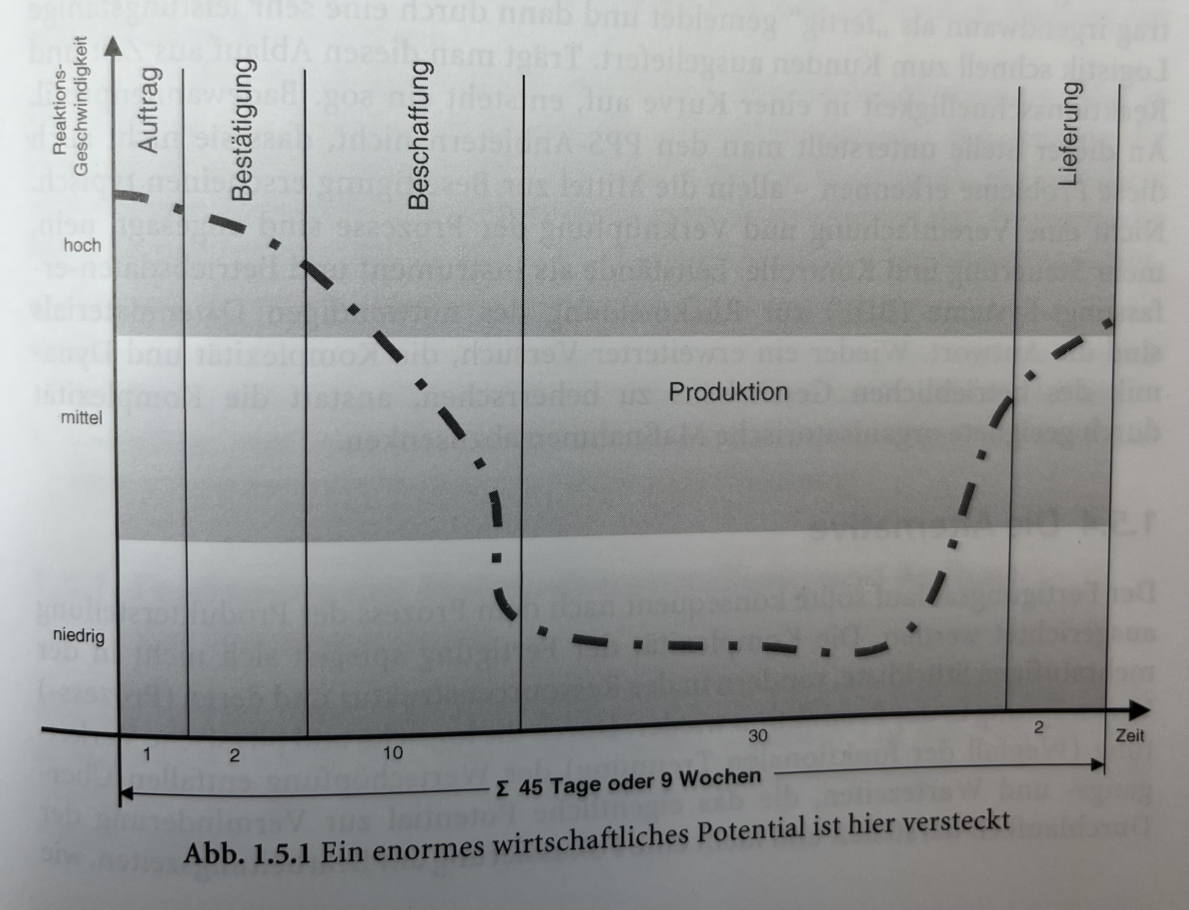
Organisation: Kanban is a part of Toyota Prod. Sys. (TPS)
Flexible Production and Material Flow → Main focus on reduced turnaround time (GER Durchlaufzeit)
Method 1: Material Planning
(PPS & MRP II-SAP)
Production time > Customer Order
Ordering material > Customer Order
High automation/ efficiency vs. flexibility
Future cannot be foreseen → planning is per se wrong
Planning scenario fail due to complexity, rapid changes, unforeseen things (resilience)
High costs for hardware, software, specialists
More Planning & Control (BDE)
Instead reduce complexity

Slide 31
Organisation: Kanban is a part of Toyota Prod. Sys. (TPS)
Flexible Production and Material Flow → Main focus on reduced turnaround time (GER Durchlaufzeit)
Method 2: Flexible Production (PULL/ HAJUNKA=levelling production/ EPEI)
„Complexity depends not on multi-BOM but structure of resources with ist combination of (production) processes
Production line, which is capable to produce always, each and every product, within a pre-defined demand (Value Stream Analysis)
Flexible material flow which support the flexible production (KANBAN & Decoupling via Supermarket)
Still „Planning“ is necessary but different approach (rough yearly demand calculated in an average daily value – rely on Fuzzy Logic (GER statistischer Ausgleichseffekt)

